Slide 1
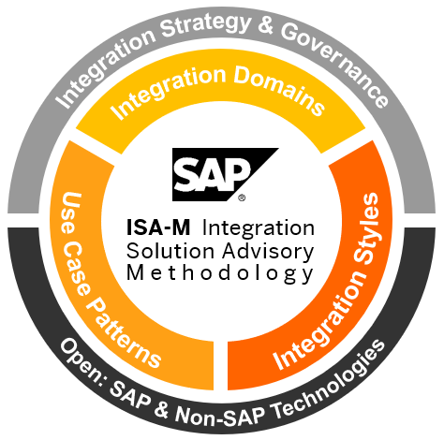

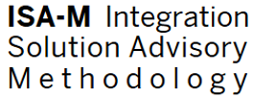
ISA-M Template
Derive Integration Guidelines for Your Organization
< Your Organization >
This document uses templates from the Integration Solution Advisory Methodology (ISA-M) provided by SAP SE. SAP SE is not responsible for the content of this document. ISA-M Template Version 3.2
Further information can be found here.

Slide 2
ISA-M Template
Overview
Overview & Terms of Use
1
Integration Roles
2
Integration Domains
3
Integration Styles & Use Cases Patterns
4
Technology Mapping
5
Interface Assessment
6
CIO Guides
7

Slide 3
ISA-M Template
Overview
Overview & Terms of Use
1
Integration Roles
2
Integration Domains
3
Integration Styles & Use Cases Patterns
4
Technology Mapping
5
Interface Assessment
6
CIO Guides
7

Slide 4
Overview
Integration Solution Advisory Methodology (ISA-M) Simplify Integration by a Systematic Integration Approach
Overview
Helps enterprise architects to shape their integration strategy
Collection of typical integration styles and patterns
Mapping to integration services (based on customer context)
Open to SAP and Non-SAP integration technologies
Target Group: Enterprise Architects / Integration Architects
ISA-M Template for Use by Customers and Partners (*)
Template to define customer-specific integration guidelines
Successfully adopted in multiple global organizations
Reusable within organizations, projects or services
Can be adapted/extended to specific needs
* Customers and partners must comply with the Terms of Use (“TOU”), see slide 5

Slide 5
Overview
ISA-M Template Terms of Use
You must comply with the following Terms of Use ("TOU") when modifying, copying, distributing, transmitting, reproducing, publishing, or creating derivative works from any of the ISA-M templates in this document. SAP reserves the right to update the TOU at any time without notice. The most current version of the TOU can be reviewed here.
Terms of Use
You are required to register at SAP Integration Architecture Community (SAP JAM Group).
You must include the Mandatory Citation in your document. You must not make any change to the Mandatory Citation.
You agree not to make any changes to Integration Style names and definitions of the Integration Solution Advisory Methodology (ISA-M).
You are entirely responsible for any content that you create using Integration Styles and templates from the ISA-M. SAP is not liable for any damage or loss caused by any content that you create.
You agree to indemnify and hold SAP, its affiliates, subsidiaries, officers, agents, partners, employees, and licensors harmless from any claim or demand, including reasonable attorneys fees, made by any third party due to or arising out of Your modifying, copying, distributing, transmitting, reproducing, publishing, or creating derivative works from any of the ISA-M templates in this document or Your usage of this ISA-M template, Your breach of this TOU or SAP's Copyright or Privacy Statements as outlined at SAP.com, or Your alleged violation of any other rights of a third party.
This ISA-M template is being provided to You AS IS, WITHOUT ANY WARRANTY, ESCROW, TRAINING, OR SERVICE OBLIGATIONS WHATSOEVER ON THE PART OF SAP. SAP MAKES NO EXPRESS OR IMPLIED WARRANTIES OF ANY TYPE WHATSOEVER, INCLUDING BUT NOT LIMITED TO IMPLIED WARRANTIES OF MERCHANTABILITY AND OF FITNESS FOR A PARTICULAR PURPOSE. YOU ASSUME ALL RISKS ASSOCIATED WITH ITS USE OF THE ISA-M TEMPLATE, INCLUDING WITHOUT LIMITATION RISKS RELATING TO QUALITY, PERFORMANCE, DATA LOSS, AND UTILITY.
SAP does not guarantee or warrant any features or qualities of the ISA-M template or give any undertaking with regard to any other quality. Statements and explanations to this ISA-M template in promotional material or on SAP.com and in the documentation are made for explanatory purposes only; they are not meant to constitute any guarantee or warranty of certain features. No warranty or undertaking shall be implied from any published SAP description of or advertisement except to the extent SAP has expressly confirmed such warranty or undertaking in writing. Warranties are validly given only with the express written confirmation of SAPs management.
SAP does not represent or endorse the accuracy or reliability of any any information provided under this ISA-M template or the ISA-M template itself. SAP shall not be liable for damages caused by the use of the content and/or information.
TO THE EXTENT ALLOWABLE BY APPLICABLE LAW, SAP AND ITS AFFILIATES, SUBSIDIARIES, OFFICERS, EMPLOYEES, AGENTS, PARTNERS, AND LICENSORS ARE NOT LIABLE TO YOU FOR ANY DIRECT, INDIRECT, INCIDENTAL, SPECIAL, PUNITIVE, CONSEQUENTIAL, OR EXEMPLARY DAMAGES, INCLUDING, BUT NOT LIMITED TO, DAMAGES FOR LOSS OF PROFITS, REVENUE, GOODWILL, USE, DATA, OR OTHER INTANGIBLE LOSSES (EVEN IF SAP HAS BEEN ADVISED OF THE POSSIBILITY OF SUCH DAMAGES), HOWEVER CAUSED, WHETHER IN CONTRACT, TORT, OR OTHERWISE, ARISING OUT OF OR RESULTING FROM: (i) THE USE OF THIS ISA-M TEMPLATE; (ii) THE COST OF PROCUREMENT OF SUBSTITUTE GOODS AND SERVICES ARISING OUT OF YOUR USE OR INABILITY TO THIS ISA-M TEMPLATE OR CONTENT, OR (iii) ANY OTHER MATTER RELATING TO THE ISA-M TEMPLATE.
SAP SE or its affiliated companies have no obligation to pursue any course of business outlined in this ISA-M template or any related presentation, or to develop or release any functionality mentioned therein. This document, or any related presentation, and SAP SE’s or its affiliated companies’ strategy and possible future developments, products, and/or platform directions and functionality are all subject to change and may be changed by SAP SE or its affiliated companies at any time for any reason without notice. The information in this document is not a commitment, promise or legal obligation to deliver any material, code, or functionality. All forward-looking statements are subject to various risks and uncertainties that could cause actual results to differ materially from expectations. Readers are cautioned not to place undue reliance on these forward-looking statements, and they should not be relied upon in making purchasing decisions.
SAP and other SAP products and services mentioned herein as well as their respective logos are trademarks or registered trademarks of SAP SE (or an SAP affiliate company) in Germany and other countries. All other product and service names mentioned are the trademarks of their respective companies. Please see http://global.sap.com/corporate-en/legal/copyright/index.epx for additional trademark information and notices.
Mandatory Citation
This document uses templates from the Integration Solution Advisory Methodology (ISA-M) provided by SAP SE. SAP SE is not responsible for the content of this document. ISA-M Template Version 3.2
Further information can be found here.

Slide 6
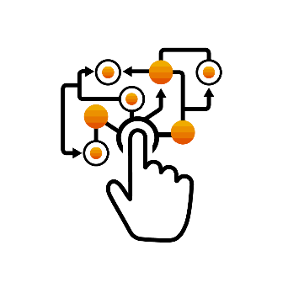
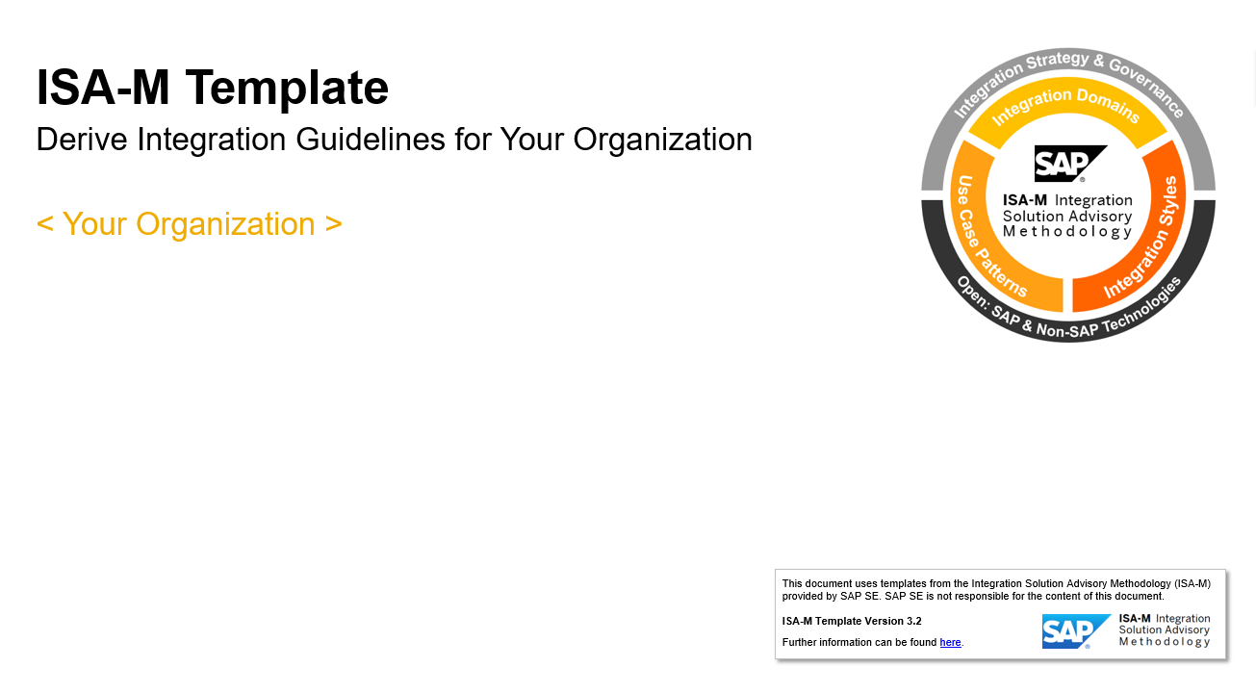


Overview
ISA-M Template Adapt and Customize To Your Specific Needs
Explanation
This element is used to introduce and describe concepts of the methodology and/or related product information.
How To Use
This element is used to give additional information on how to apply the ISA-M template to your customer context.

Slide 7
Overview
ISA-M Template Document History
Version | Date | Changes
3.0 | September, 2016 | Updated description of integration domains Updated descriptions of integration styles New category ‘Enabling Services’ to capture integration related technologies Updated descriptions of reference use case patterns Updated decision table templates
3.1 | March, 2017 | Updated template to reflect naming changes in SAP Cloud Platform
3.2 | October, 2018 | Updated descriptions and examples for all integration styles, use case patterns and sample integration technology mappings Added information on SAP’s integration strategy for the intelligent enterprise and the role of ISA-M (slide 8-9) Added overview on ISA-M use cases for enterprise architects (slide 11-12) Added ‘How to Use’ and ‘Explanations’ to slides to give additional information on how ISA-M can be adapted by customers Added typical integration roles and their responsibilities (slide 15-17) Updated examples for integration technology mappings including links to further product information (slide 32-74) Added additional guidance based on integration patterns: Integration Layer vs. Application Layer (slide 44) Integration Layer vs. API Management Layer (slide 73) Added section and links for CIO Guides (slide 81-82) Added integration domain (slide 19) Business-to-Government (B2G) Renamed ‘Integration Solution Advisor Methodology’ to ‘Integration Solution Advisory Methodology’ Renamed Integration Styles to more ‘classical names’ (all slides) ‘Process Invocation’ to ‘Process Integration’ ‘Data Movement’ to “Data Integration” ‘User-Centric Consumption to ‘User Integration’ ‘Enabling Services’ to ‘Cross Use Cases’ Added new use case patterns (slide 30) API-Managed Integration Event-Based Integration Stream Analytics

Slide 8
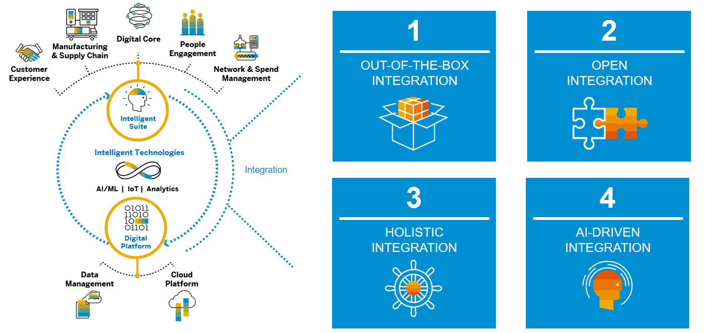
Overview
Intelligent Enterprises are Integrated Enterprises SAP’s Integration Strategy for the Intelligent Enterprise
Explanation
Integration is a key enabler for intelligent enterprises. SAP’s integration strategy for the intelligent enterprise is based on four core principles. ISA-M complements SAP’s technology portfolio by a methodology that helps enterprise architects to shape their integration strategy. ISA-M provides a holistic view on integration including all types of integration use cases needed for full E2E integration.

Slide 9
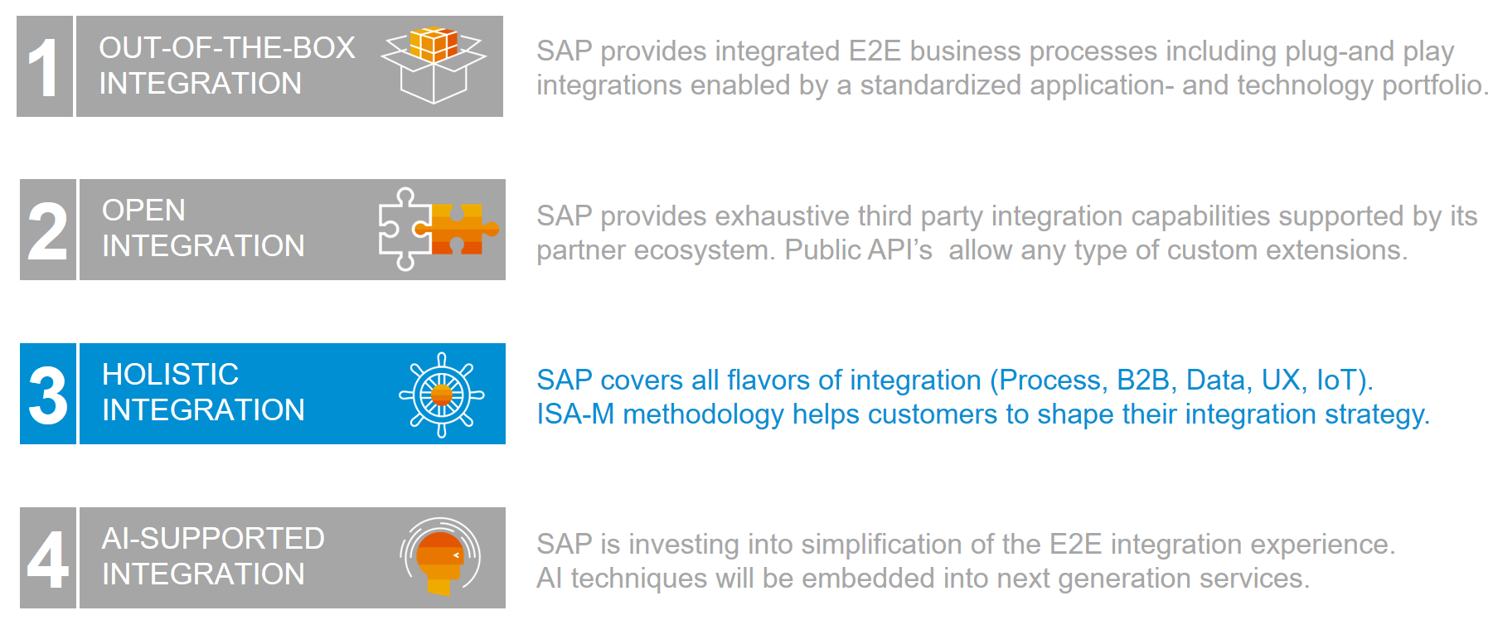
Overview
Intelligent Enterprises are Integrated Enterprises SAP’s Integration Strategy for the Intelligent Enterprise
Explanation
ISA-M supports the holistic integration principle by providing a systematic methodology for enterprise architects to define, asses and evolve their integration architecture. It supports enterprise architects in defining integration guidelines for their organizations and allows to include SAP as well as Non-SAP integration technologies / services (depending on the customer context).

Slide 10
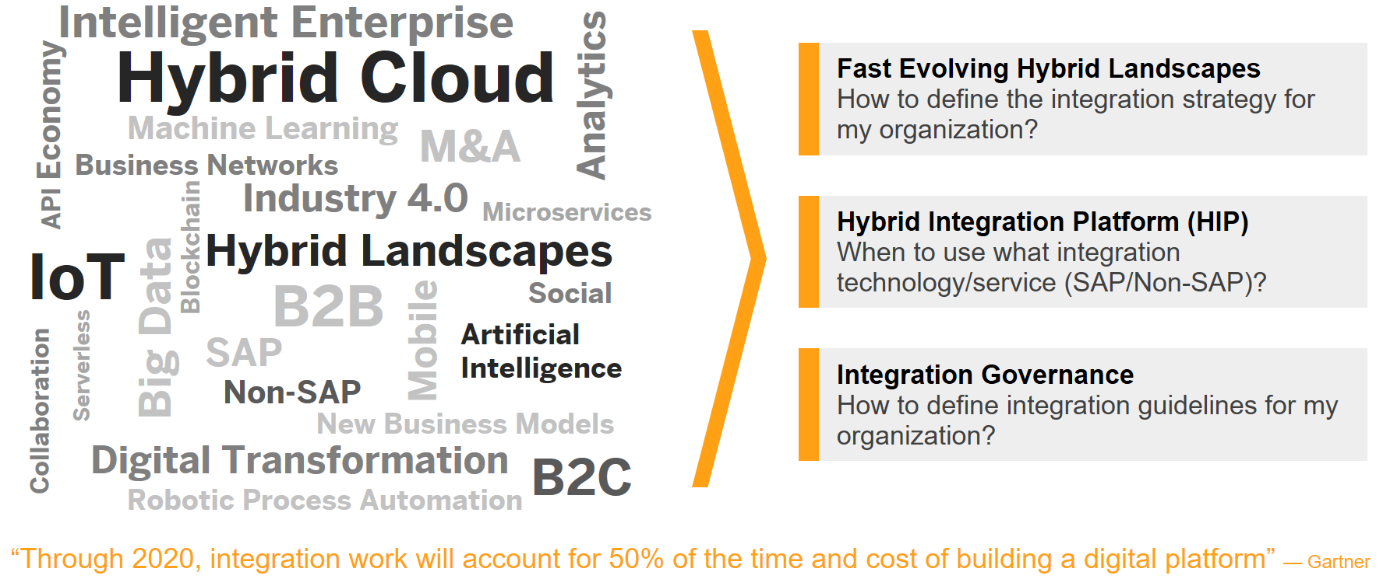
Overview
Integration Challenge for Enterprise Architects The Increased Scope of Integration

Slide 11




Overview
ISA-M: Use Cases for Enterprise Architects Simplify Integration by a Systematic Integration Approach
1
2
3
Common Terminology
Integration Strategy Definition
Integration Governance & Hybrid Integration Platform
Provide holistic view on integration (technology-agnostic)
Review your current integration architecture
Define integration guidelines for your organization
Improve communication between teams and system integrators
Define your target integration architecture
Blueprint your Hybrid Integration Platform (SAP/Non-SAP)
Establish knowledge sharing culture (best practices)
Identify future building blocks (e.g. for POCs)
Define areas for self-service integration
How To Use
This slide provides an overview on how ISA-M can be applied in organizations. Depending on the specific needs of your organization you can flexibly select from the possible use cases and use the ISA-M template as a starting point and adapt/extend it to your specific needs. Based on this template, you can create your customer-specific integration strategy and/or guidance document(s).

Slide 12





Overview
ISA-M: Increase Your Integration Maturity Level Simplify Integration by a Systematic Integration Approach
4
3
Self-Service Integration
2
Integration Governance & HIP
1
Integration Strategy Definition
Common Terminology
0
Ad Hoc Integration
Integration Solution Advisory Methodology (ISA-M)
Explanation
This slide shows how you can increase your integration maturity level by moving from an ad-hoc integration practice to a more systematic way of integration. Based on established integration standards, you could also define areas for self-service integration e.g. by allowing citizen integrators to implement simple integration scenarios on their own within the context of your overall integration governance.

Slide 13
Integration Domains
Integration Styles
Technology Mapping
ISA-M in a Nutshell Simplify Integration by a Systematic Integration Approach
Explanation
Integration domains describe typical areas in a hybrid landscape where integration is needed. Integration styles and use case patterns comprise a set of typical, technology-agnostic integration use cases. Finally, integration styles and use cases can be mapped to integration technologies/services (SAP and/or Non-SAP) based on a given customer context.

Slide 14
ISA-M Template
Overview
Overview & Terms of Use
1
Integration Roles
2
Integration Domains
3
Integration Styles & Use Cases Patterns
4
Technology Mapping
5
Interface Assessment
6
CIO Guides
7

Slide 15









Integration Roles
Integration Roles – Overview Sample Integration Roles and Responsibilities
Enterprise Architect
Integration Architect
Integration Developer
Integration Administrator
Business Domain Expert
Business User
Citizen Integrator
Application/API Developer
How To Use
ISA-M includes frequently used integration roles in organizations, together with their typical responsibilities and some sample activities in the context of SAP. The concrete definition of integration roles depends on your specific customer context. You can use the outlined integration roles as a starting point and adapt/extend them to your specific needs. These roles, for example, can help you to establish an integration competency center within your organization and derive areas for self-service integration (e.g. simple integration tasks covered by citizen integrators).

Slide 16
Integration Roles
Integration Roles – Definitions I Sample Integration Roles and Responsibilities
Enterprise Architect
Integration Architect
Integration Developer
Integration Administrator
Responsibilities
Responsibilities
Responsibilities
Responsibilities
Definition, communication, and continuous improvement of an integration reference architecture based on an overall IT strategy
Definition of integration standards and technology selection guidelines (cross-vendor, hybrid integration platform)
Evaluation of new integration technologies / services
Definition of technical integration architectures with a focus on specific integration technologies / services
Definition of technical specifications for integration scenarios based on business requirements
Definition and communication of patterns, templates, and best practices
Implementation and test of integration scenarios based on technical specifications
Implementation and extension of prepackaged integration scenarios
Technical setup and operations of integration scenarios (for example, archiving or certificate management)
Technical monitoring of interfaces, including root-cause analysis and technical error handling
Sample Tasks in SAP Context
Sample Tasks in SAP Context
Sample Tasks in SAP Context
Sample Tasks in SAP Context
Definition and rollout of company-wide technology selection guidelines using the ISA-M
Roll-out of integration standards
Definition of development guidelines for SAP Cloud Platform Integration or SAP Process Orchestration
Definition of best practices for integration flows for SAP Cloud Platform Integration, for example, based on enterprise integration patterns*
Implementation of integration flows in SAP Cloud Platform Integration or SAP Process Orchestration
Implementation of data orchestration flows in the SAP Data Hub solution
Technical monitoring of messages from SAP Cloud Platform Integration in SAP Solution Manager
Deployment of certificates in SAP Cloud Platform Integration
* Gregor Hohpe and Bobby Woolf, Enterprise Integration Patterns, 2003

Slide 17
Integration Roles
Integration Roles – Definitions II Sample Integration Roles and Responsibilities
Business Domain Expert
Business User
Citizen Integrator
Application/API Developer
Responsibilities
Responsibilities
Responsibilities
Responsibilities
Specification of business requirements for a specific business process domain or line of business
Semantic definition of interface customizations and messages mapping (together with an integration architect)
Processing of workflow tasks
Interacting with business applications (omni-channel access)
Monitoring and error correction of messages in a specific business process domain or line of business
Business user with the ability to perform some integration tasks independently (self-service)
Elimination of need for deep integration knowledge
Customization of enterprise applications
Provisioning of customer-specific APIs
Development of extension applications or mobile applications
Sample Tasks in SAP Context
Sample Tasks in SAP Context
Sample Tasks in SAP Context
Sample Tasks in SAP Context
Definition of customized B2B interfaces and mappings in the Integration Content Advisor for SAP Cloud Platform Integration
Processing of workflow tasks, e.g. in SAP Cloud Platform Workflow
Error correction, canceling, or restart of messages in the SAP Application Interface Framework as part of SAP S/4HANA or SAP Business Suite applications
Implementation of simple integration scenarios by HR business users in the integration center of SAP SuccessFactors
Integration of buyers and suppliers in the SAP Ariba Cloud Integration Gateway solution based on a self- service wizard approach
Customization of applications with SAP S/4HANA
Development of extension applications on SAP Cloud Platform
Development of innovate, API-based applications (e.g. for fast innovation cycles, bimodal IT)

Slide 18
ISA-M Template
Overview
Overview & Terms of Use
1
Integration Roles
2
Integration Domains
3
Integration Styles & Use Cases Patterns
4
Technology Mapping
5
Interface Assessment
6
CIO Guides
7

Slide 19














Integration Domains
Integration Styles
Technology Mapping
Integration Domains* Typical Integration Areas in a Hybrid Landscape
User-Centric Applications
Real World Objects
Non-SAP Clouds
Non SAP Cloud Apps
User2Cloud
Cloud2Cloud
Thing2Cloud
…
C/4 HANA
Business Partner
Government Agency
Cloud
OnPremise2Cloud
B2B
B2G
On-Premise
Business Suite
Non SAP
Business Suite
User2OnPremise
OnPremise2OnPremise
Thing2OnPremise
Integration Domain
* Further domains possible

Slide 20

Integration Domains
Integration Styles
Technology Mapping
Integration Domains High-Level Assessment of Your Integration Architecture
Integration Domain | Relevance |  |  | Integration Services / Technologies
 | Relevant | Not Relevant | Under Evaluation | As Is | To Be
OnPremise2OnPremise
OnPremise2Cloud
Cloud2Cloud
B2B
B2G
User2OnPremise
User2Cloud
Thing2OnPremise
Thing2Cloud
How To Use
Integration domains provide the entry point into ISA-M and can be used as a “big picture” for integration. You can do an assessment of your integration architecture by selecting the integration domains that are relevant for your organization or that you might want to further evaluate. Next, you can list your current integration technologies / services (As Is) and also derive your future target architecture (To Be). Integration domains are technology agnostic and can therefore also help in blueprinting a hybrid integration platform consisting of multiple integration services/technologies (SAP/Non-SAP). You could also remove integration domains that are not relevant in your organization.

Slide 21
ISA-M Template
Overview
Overview & Terms of Use
1
Integration Roles
2
Integration Domains
3
Integration Styles & Use Cases Patterns
4
Technology Mapping
5
Interface Assessment
6
CIO Guides
7

Slide 22
Integration Domains
Integration Styles
Technology Mapping
Integration Styles Four Fundamental Archetypes of Integration*
Process Integration
Data Integration
User Integration
Thing Integration
How to chain business processes across business applications?
How to synchronize data between business applications?
How to integrate user-centric applications with business applications?
How to integrate real- world things with business applications?
Explanation
Integration styles describe basic categories or types of integration: process-, data-, user-, and thing-centric integration. Each integration style has specific characteristics and can be refined by use-case patterns (see following slides). Integration styles build the key pillar of ISA-M.
* In the next ISA-M update, we plan to add Analytics Integration as an additional integration style

Slide 23




Integration Domains
Integration Styles
Technology Mapping
Integration Styles Technology-Agnostic: Open to SAP and Non-SAP
Integration Styles cover key integration archetypes: the process integration style connects business processes across applications whereas the data integration style allows to synchronize or access data across applications. The user integration style allows to connect user-centric applications (e.g. mobile apps) with applications whereas the thing integration style allows to connect real world objects (e.g. sensors, machines) with applications. All integration styles are technology agnostic and are applicable within multiple integration domains (e.g. cloud, on-premise, hybrid).
Cross Use Cases build a category for all integration-related use cases that complement one ore more of the four core integration styles. For example, API-Managed Integration provides full-lifecycle management for APIs that, e.g. can be leveraged in user- or process-centric integration scenarios. Workflow Management is an other example for a cross use case as it can spawn across process- user and data centric integration scenarios. Further examples in this category will be explained on the next slides such as Event-Based Integration.
User-Centric Application
Real-World Things
Explanation
Mobile
Browser
Desktop
Device
Sensor
Asset
Interaction Logic
Interaction Logic
User Integration
Cross Use Cases
Thing Integration
Business Logic
Process Integration
Business Logic
Data
Data Integration
Data
On-Premise
Cloud
On-Premise
Cloud
Application
Application

Slide 24
Integration Domains
Integration Styles
Technology Mapping
Integration Styles Key Characteristics and Decision Criteria
 | Process Integration | Data Integration | User Integration | Thing Integration
Objective | Chaining of business processes | Synchronization of data | Omni-channel access to backend applications | Capturing and processing of real world data
Interaction Type | System-2-System | System-2-System | User-2-System | Thing-2-System
Coupling to Application | Process-Level | Data-Level | UI-Level | Data-Level / Process Level
Primary Trigger | Application Event | Schedule or Application Event | User Event | Thing Event
Urgency of Completion | (Near) Real-Time | Batch or Near Real-Time | (Near) Real-Time | (Near) Real-Time or Batch
Unit of Data Exchange | Single Objects | Bulk-Data or Single Objects | Single Objects or Bulk-Data | Single Objects or Bulk-Data
Specific Requirements | Transactional Integrity Reliable Messaging Message Orchestration B2B protocol support | Data Orchestration Complex transformations Data Quality Management Big Data Processing | Online / Offline Support Device Management End-User Management Application Management | Thing Management Edge Intelligence IoT protocol support Event Stream Processing
How to Use
This slide summarizes typical characteristics per integration style. It can help enterprise architects / integration architects to map integration styles to relevant capabilities of integration technologies / services (as part of the technology mapping). The listed criteria can be used as a starting for discussion and could be further refined in your specific context.

Slide 25

Integration Domains
Integration Styles
Technology Mapping
Integration Styles and Use Case Patterns Technology-Agnostic Library of Integration Use Cases
Integration Styles
Use Case Patterns: Each integration style can be refined by use case patterns which describe frequently found integration use cases in enterprise landscapes. Based on the same principles, the cross use cases category comprises use case patterns that complement one ore more of the four core integration styles – e.g. API-Managed Integration or Event-Based Integration. Use Case Patterns are technology-agnostic
Extensible Library: ISA-M includes a typical set of use case patterns that you can use as a starting point for your organization. You can flexibly adjust the library of use case patterns to your specific needs e.g. by adding additional customer-specific use case patterns or removing patterns that are not relevant in your organization. In the next slides, all use case patterns are described in more detail including an example in the context of SAP.
How To Use
Process Integration
Data Integration
User Integration
Thing Integration
A2A Integration
Master Data Synchronization
UI Integration
Thing to Analytics
B2B Integration
Data Replication
Mobile Integration
Thing to Process
Business Network Integration
Data Virtualization
Desktop Integration
Thing to Data Lake
Use Case Patterns
Customer-Specific Use Case
Data Quality Management
…
Thing to Thing
…
…
…
…
Cross Use Cases
API-Managed Integration
Event-Based Integration
Stream Analytics
Workflow Management
…

Slide 26

Integration Domains
Integration Styles
Technology Mapping
Process Integration Style Use Case Patterns
A2A Integration
B2B Integration
Business Network Integration
Chaining of business process steps between business applications by the exchange of transactional data.
Chaining of business process steps between business partners by the exchange of transactional data leveraging standard B2B protocols.
Chaining of business process steps between business partners managed by a business network.
Application
Application
Partner 1
Partner 2
Partner 1
Partner 2
Application
Application
Application
Application
Business Network
Example: Lead-to-cash process with integration of SAP C/4HANA and SAP S/4HANA: exchange of sales orders.
Example: Design-to-operate process with integration of a manufacturer with suppliers: exchange of purchase orders using B2B standards like ANSI X.12 or UN/EDIFACT.
Example: Source-to-pay process with the integration of buyers and suppliers through the SAP Ariba business network: exchange of purchase orders and invoices.

Slide 27

Integration Domains
Integration Styles
Technology Mapping
Data Integration Style Use Case Patterns
Master Data Synchronization
Data Replication
Data Virtualization
Data Quality Management
API-based synchronization of master data from a system of records with other applications (initial load, delta transfer).
s
Table-based integration of data covering data replication, migration, or analytical use cases based on ETL/ELT¹.
Provisioning of a virtual data layer by federation of queries to remote data sources without physical data movement.
Integration of data from multiple sources for cleansing, matching or consolidation (central business terms).
Application
Application
Data Source
Data Source
System of Records
App / DWH
Virtual Data Layer
DQM
Application
DB
Data Source
Data Source
Example: Synchronization of cost center data between SAP S/4HANA and SAP SuccessFactors.
Example: Replication of data from legacy applications or databases into SAP HANA e.g. for migration, analytics or big data warehousing.
Example: Lookup of shared master data from various data sources, e.g. Virtual data access in SAP HANA to remote data sources.
Example: Cleansing of address data. Embedded DQM services in apps to validate address data and/or enrich with geocodes.
¹ Also APIs might be used for this use case

Slide 28



Integration Domains
Integration Styles
Technology Mapping
User Integration Style Reference Use Case Patterns
UI Integration
Mobile Integration
Desktop Integration
Integration of multiple application UIs into a single point of entry including the consumption of backend application services in a web user interface.
Consumption of backend application services in a mobile app, leveraging native or hybrid device capabilities including offline data synchronization.
Consumption of backend application services in a desktop application leveraging native desktop capabilities.
Application
Application
Application
Web UI
Mobile App
Desktop App
Application
Application
Application
Example: SAP Fiori Launchpad that provides a single point of entry into SAP business application like SAP S/4HANA or SAP SuccessFactors.
Example: iOS or Android mobile apps that access data from on-premise or cloud-based data sources via OData with offline data synchronization.
Example: SAP Gateway for Microsoft Office Integration

Slide 29


Integration Domains
Integration Styles
Technology Mapping
Thing Integration Style Use Case Patterns
Thing to Analytics
Thing to Process
Thing to Data Lake
Thing to Thing
Real-time integration of thing or machine data for monitoring and analytics.
Integration of thing or machine data for triggering a business process step.
Collection of thing or machine data to derive future value out of it (e.g. by machine learning).
Exchange of data between two or more things, e.g. machine-to-machine (M2M).
Thing
Thing
Thing
Analytical Application
Business Application
Data Lake
Thing
Thing
Thing
Thing
Thing
Example: Monitoring of connected devices or machines and to gain real-time visibility of shop floor based production operations.
Example: Triggering of a service order process based on machine alerts (e.g. in the context of SAP Predictive Maintenance & Service).
Example: Optimizing asset maintenance with anomaly detection, spectral analysis, and machine learning algorithms.
Example: Communication between two robots during production process.

Slide 30

Integration Domains
Integration Styles
Technology Mapping
Cross Use Cases Use Case Patterns
API-Managed Integration
Event-Based Integration
Stream Analytics
Workflow Management
Provisioning of omni-channel and secure access to business applications by managed APIs.
Decoupling of applications, extensions or IoT data by messaging principles (pub/sub).
Real-time processing & analytics of event streams including the reaction on event patterns.
Automation and extension of business processes that spawn across multiple applications.
API Consumption Layer
Application
Mobile
Thing
Input Streams
Event Stream Processing
Application
Workflow Management
Managed API
Managed API
Pub/Sub
Pub/Sub
Application
API Management
Event Brokering
API
Task
API
Application Layer
Pub/Sub
Pub/Sub
Application
UI / Mobile
…
Application
Application
…
…
…
…
Application
Application
…
…
…
Example: Expose APIs to business partners. Managed APIs leverage API traffic management policies, API security policies and API Analytics.
Example: Event-driven extensions for SAP S/4HANA: Application extensions can react to events from SAP S/4HANA out-of-the-box.
Example: Monitor incoming IoT-, click-, social media- or business transaction streams for trends, patterns or correlations and respond in real time.
Example: Extension of SAP S/4 HANA core business processes with additional process logic such as approval steps involving interactive user tasks.

Slide 31
Integration Domains
Integration Styles
Technology Mapping
Advanced View: Integration Patterns Combination of Integration Domains and Integration Styles
OP2OP
OP2Cloud
Cloud2Cloud
B2B/B2G
User2OP
User2Cloud
Thing2OP
Thing2Cloud
 |  | N/A | N/A
 |  | N/A | N/A
 |  | N/A | N/A
 |  | N/A | N/A
N/A | N/A |  | N/A
N/A | N/A |  | N/A
N/A | N/A | N/A
N/A | N/A | N/A
To derive integration guidelines for complex landscapes, the combination of integration domains and integration styles might be required. On this slide, possible combinations of integration domains and integration styles are listed. Each combination is defined as an integration pattern (IP-1 to IP-12).
Example: If you want to define a policy for process integration between two cloud applications your can refer to IP-3.
Important Note: This step is optional and might be helpful for complex landscapes where fine-grained integration guidelines need to be defined. Please skip, if not useful for your orgnaization.
IP-1
IP-5
How To Use
IP-2
IP-6
IP-3
IP-7
IP-4
IP-8
Integration Domain
IP-9
IP-10
IP-11
IP-12
Process Integration | Data Integration | User Integration | Thing Integration
Integration Style

Slide 32
ISA-M Template
Overview
Overview & Terms of Use
1
Integration Roles
2
Integration Domains
3
Integration Styles & Use Cases Patterns
4
Technology Mapping
5
Interface Assessment
6
CIO Guides
7

Slide 33

Integration Domains
Integration Styles
Technology Mapping
Integration Technology Mapping Overview
Integration Styles
Process Integration
Data Integration
User Integration
Thing Integration
Cross Use Cases
Technology-Agnostic Concepts
Use Case Patterns
P1
P2
…
D1
D2
…
U1
U2
…
T1
T2
…
C1
C2
…
Integration Technologies
T1
T2
T3
T4
T5
T6
…
SAP and/or Non-SAP Components
How To Use
In the third step of the methodology, integration styles and use case patterns (all technology-agnostic) can be mapped to integration technologies or services that should be used in your customer context (SAP and/or Non-SAP). This mapping highly depends on your specific customer context – some sample factors that might need to be considered are listed on the next slide. This allows you to derive your own decision framework.

Slide 34



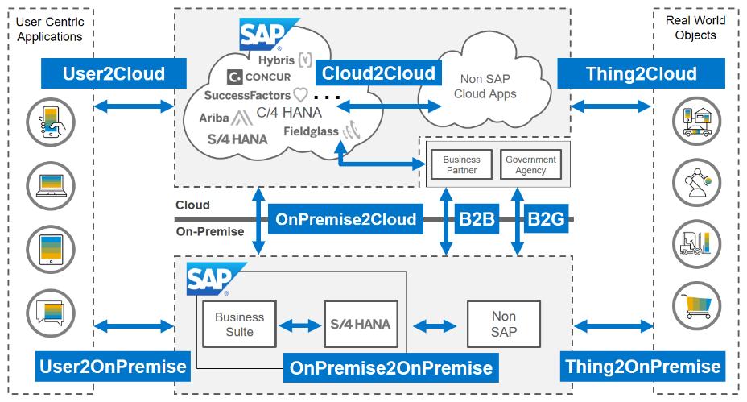



Integration Domains
Integration Styles
Technology Mapping
Integration Technology Mapping Customer Context
Industry & Business Requirements
Existing & Future Application Landscape
IT / Enterprise Architecture Strategy
Existing Investments
Availability of Pre-Packaged Content
Existing Skillsets
…
How To Use
The mapping to integration technologies / services highly depends on your specific customer context. This slide shows some sample factors that might need to be evaluated or considered in your organization. The listed factors can be adapted/extended to your specific needs.

Slide 35
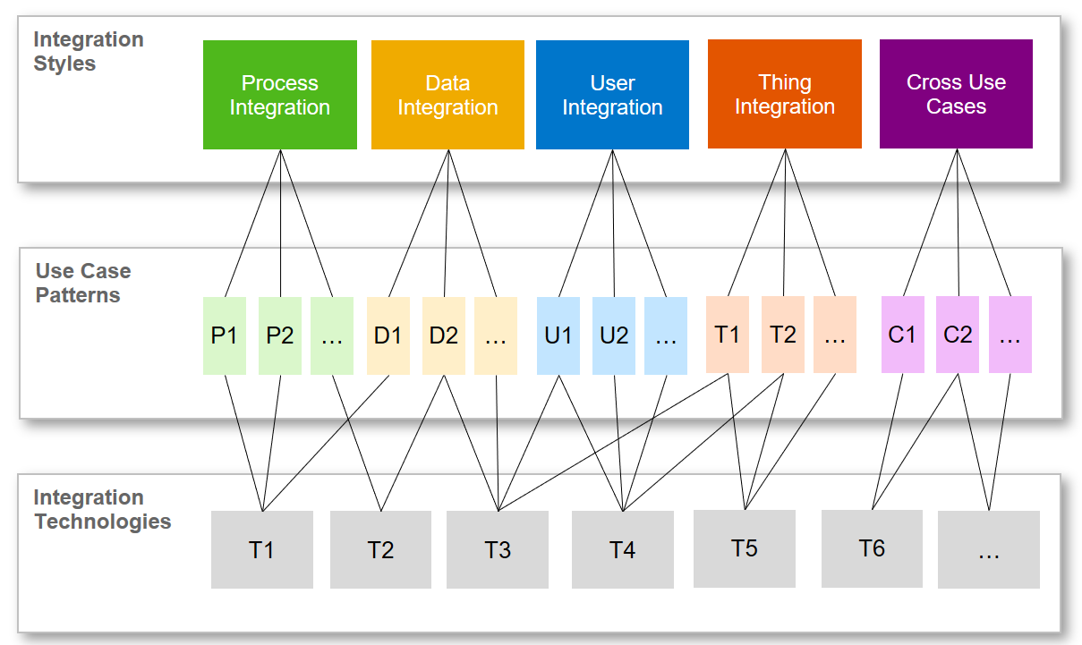
Integration Domains
Integration Styles
Technology Mapping
Integration Technology Mapping Recommendation Degrees
How To Use
ISA-M foresees various levels of recommendation degrees that you can assign to integration technologies / services in your organization. This allows you to define integration guidelines for your organization including default recommendations, reasonable alternatives, possible exceptions or techniques that you would like to avoid in your organization. The table below provides some further explanations.
Recommendation Degree | Description
General Recommendation | Assign this degree to your default recommendation for a specific integration style and/or use case pattern, e.g. if you want to establish SAP Cloud Platform Integration as your company standard for hybrid or cloud integration scenarios.
Reasonable Alternative | Assign this degree to possible alternatives that are valid for specific integration scenarios, e.g. if you want to allow certain SAP-to-SAP scenarios to be implemented with a direct integration approach e.g. for migration purposes.
Possible Exception | Assign this degree to possible exceptions for your general recommendations that you would like to allow for restricted use cases, e.g. if you want to allow for some restricted scenarios file-based interfaces.
To Be Avoided | Assign this degree to explicitly cover integration techniques / approaches that you would not like to be further used for new integration scenarios, e.g. to phase out some non strategic integration technologies in you organization.

Slide 36
Integration Domains
Integration Styles
Technology Mapping
Integration Technology Mapping Derive Integration Guidelines for Your Organization
A
B
C
D
E
Process Integration
Data Integration
User Integration
Thing Integration
Cross Use Cases
Explanation
In the next sections, decision table templates are provided per integration style (A to E) that allow you to define integration guidelines for your organization. This template also includes examples on how to map integration styles to technologies/services from the SAP portfolio (based on a typical hybrid landscape).
The technology mappings given in the next slides are only illustrative examples that need to be aligned with your specific customer context.

Slide 37
Integration Domains
Integration Styles
Technology Mapping
Integration Technology Mapping Derive Integration Guidelines for Your Organization
A
B
C
D
E
Process Integration
Data Integration
User Integration
Thing Integration
Cross Use Cases

Slide 38









Integration Domains
Integration Styles
Technology Mapping
Process Integration Style Overview
Real World Objects
This section provides a decision table template (slide 40) that allows you to define integration guidelines for the process integration style for your organization including the highlighted integration domains. ISA-M is open to also include Non-SAP integration technologies/services.
The ISA-M template also includes examples on how to map this integration style to sample technologies/services from the SAP portfolio. Where applicable, we have also added references to the CIO Guides for Integration or links to other documents where you will find more information.
Important Note: The sample technology mappings given in the next slides are only illustrative examples that need to be aligned with your specific context and requirements. SAP also provides consulting services in case you need further support.
User-Centric Applications
Non-SAP Clouds
How To Use
Non SAP Cloud Apps
User2Cloud
Cloud2Cloud
Thing2Cloud
Cloud2Cloud
…
C/4 HANA
Business Partner
Government Agency
Cloud
OnPremise2Cloud
B2B
OnPremise2Cloud
B2B
B2G
On-Premise
B2G
Business Suite
Non SAP
Business Suite
User2OnPremise
OnPremise2OnPremise
Thing2OnPremise
Process Integration
Process Integration
Data Integration
User Integration
Thing Integration
Cross Use Cases

Slide 39
Integration Domains
Integration Styles
Technology Mapping
Process Integration Style Sample Technology Mapping
1
Integration Domain(s) and Integration Style
2
Sample Mapping to SAP Technologies / Services
User-Centric Applications
Real World Objects
SAP Cloud Platform Integration Suite
SAP’s IPaaS for cloud and hybrid integration
Prepackaged content for SAP and non-SAP apps
Integration Content Advisor for SAP Cloud Platform Integration (Leverage machine learning to significantly reduce integration efforts)
SAP Cloud Platform Open Connectors (+150 pre-built connectors for Non-SAP apps)
Complementary: SAP Process Orchestration and SAP Application Interface Framework (AIF)
Key Characteristics
A2A, B2B/B2G, master data synchronization use cases
API-based integration and near real-time processing
Transactional process integrity
Non-SAP Clouds
Non SAP Cloud Apps
User2Cloud
Cloud2Cloud
Thing2Cloud
Cloud2Cloud
…
C/4 HANA
Business Partner
Government Agency
Cloud
OnPremise2Cloud
B2B
OnPremise2Cloud
B2B
B2G
On-Premise
B2G
Business Suite
Non SAP
Business Suite
User2OnPremise
OnPremise2OnPremise
Thing2OnPremise
Process Integration
Process Integration
Data Integration
User Integration
Thing Integration
Cross Use Cases

Slide 40
Integration Domains
Integration Styles
Technology Mapping
Process Integration Style Decision Table Template
Integration Guidelines
Integration Technology / Service Sample Values: 1) SAP Cloud Platform Integration 2) SAP Process Orchestration 3) SAP Application Interface Framework 4) Non-SAP … | Recommendation Degree Sample Values: 1) General Recommendation 2) Reasonable Alternative 3) Possible Exception 4) To be avoided … | Description Optionally: refer to use case patterns | Relevant Integration Domains
 |  |  | OP2OP | OP2Cloud | Cloud2Cloud | B2B/B2G
SAP Cloud Platform Integration | General Recommendation | Use for all hybrid and cloud-to-cloud scenarios leveraging pre-packaged integration content. |  | ● | ●
SAP Process Orchestration | General Recommendation | Use for all on-premise to on-premise integration scenarios including B2B/B2G scenarios. | ● |  |  | ●
SAP Application Interface Framework | General Recommendation | Use complementary to SAP Cloud Platform Integration and SAP Process Orchestration as part of SAP S/4HANA. Provides deep integration capabilities into the application layer. | ● | ● |  | ●
… | … | …
How To Use
This table allows you to define integration guidelines for the process integration style for your organization. Per row, you can add one integration guideline: In column 1, you can select the relevant integration technology/service for which you want to define the guideline (e.g. SAP Cloud Platform Integration). In column 2, you can define the recommendation degree that you would like to assign to the integration technology/service within your organization (e.g. General Recommendation). In column 3, you can further describe your integration guideline, optionally by referring to the relevant use case patterns. Column 4 allows you to assign the integration technology/service to the relevant integration domain(s), e.g. OnPremise2Cloud or Cloud2Cloud. Please adjust the decision template to your specific needs.
Important Note: The sample technology mappings shown in the table above are only illustrative examples that need to be aligned with your specific context and requirements. Also the inclusion of Non-SAP integration technologies / services is possible.

Slide 41
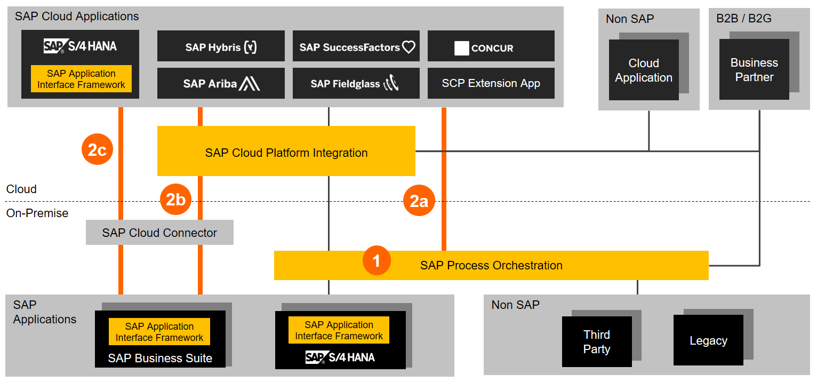
Integration Domains
Integration Styles
Technology Mapping
Process Integration Style SAP Cloud Platform Integration & SAP Process Orchestration
Explanation
SAP Cloud Platform Integration and SAP Process Orchestration build the foundation of SAP’s integration strategy for supporting A2A, B2B, B2G and master data synchronization use cases. Both technologies are complementary.
Source and further Information: CIO Guide: Process and Data Integration in Hybrid Landscapes.

Slide 42
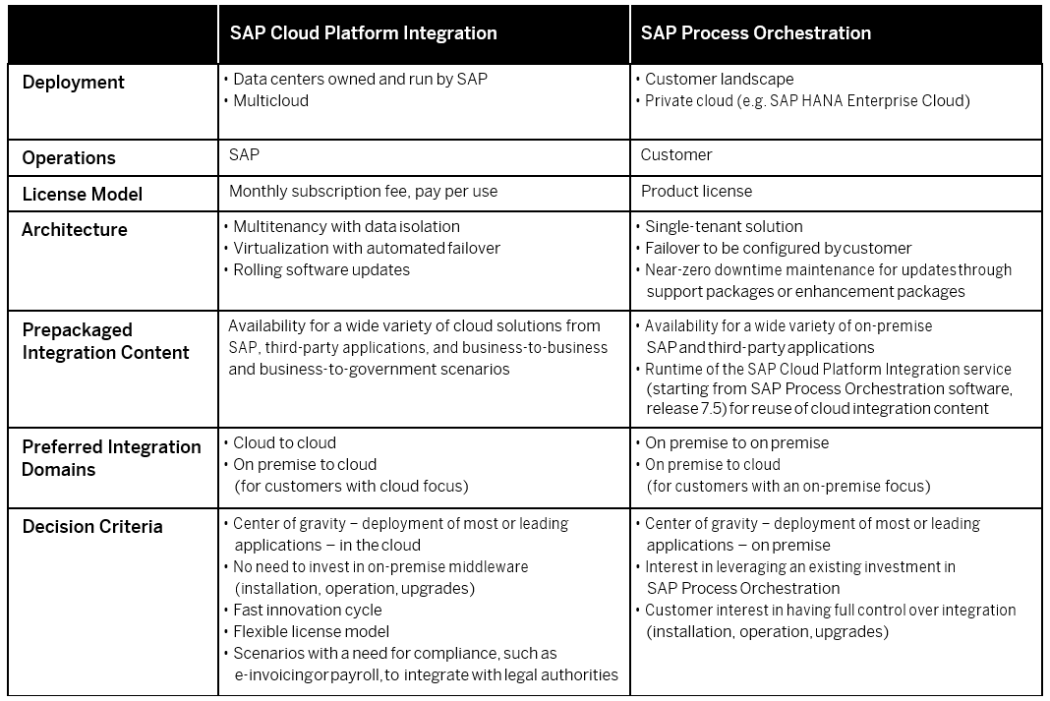
Integration Domains
Integration Styles
Technology Mapping
Process Integration Style SAP Cloud Platform Integration & SAP Process Orchestration
SAP Cloud Platform Integration and SAP Process Orchestration build the foundation of SAP’s integration strategy for supporting A2A, B2B, B2G and master data synchronization use cases. Both technologies are complementary.
Source and further Information: CIO Guide: Process and Data Integration in Hybrid Landscapes.
How To Use

Slide 43
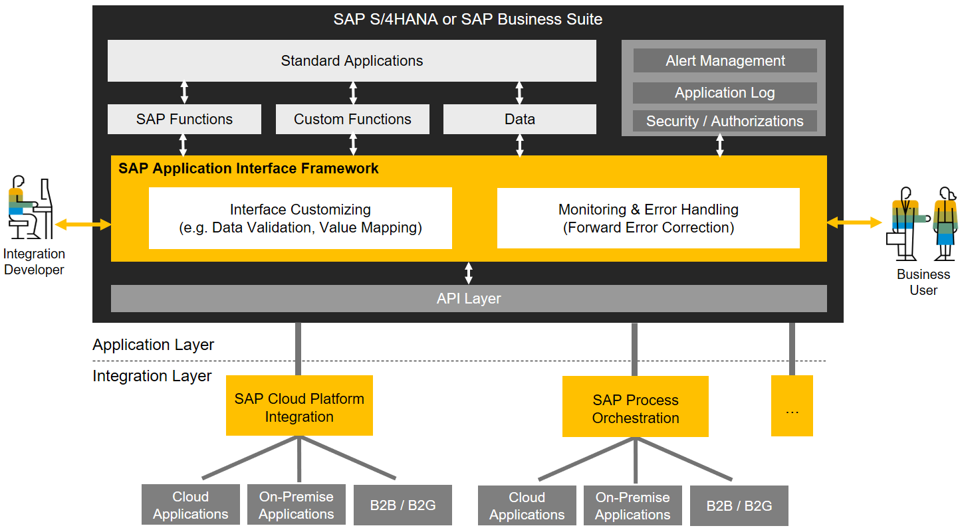
Integration Domains
Integration Styles
Technology Mapping
Process Integration Style SAP Application Interface Framework (AIF)
Explanation
SAP Application Interface Framework (AIF) complements SAP Cloud Platform Integration and SAP Process Orchestration with a deep integration capability into the application layer of SAP S/4HANA or SAP Business Suite. Among others, it provides monitoring and error handling for business users.
Source and further Information: CIO Guide: Process and Data Integration in Hybrid Landscapes.

Slide 44
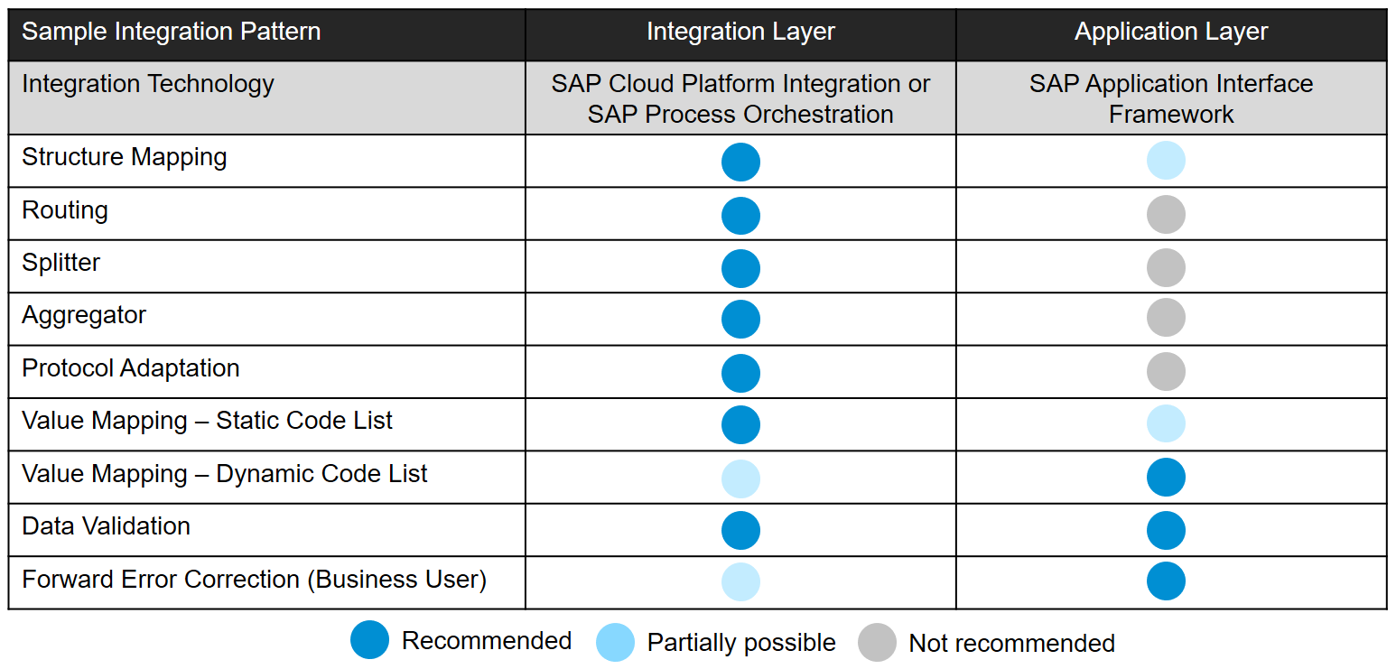
Integration Domains
Integration Styles
Technology Mapping
Process Integration Style Sample Integration Patterns – Integration and Application Layer
Explanation
A key question for integration architects is which patterns to implement in the integration layer and which patterns to implement in the application layer. This slide lists some typical patterns and their best practices and can be extended/adapted to capture best practices in your organization.
Source and further Information: CIO Guide: Process and Data Integration in Hybrid Landscapes.

Slide 45
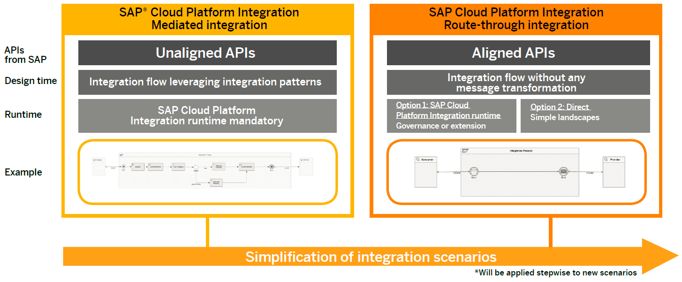
Integration Domains
Integration Styles
Technology Mapping
Process Integration Style Simplification: Evolution of SAP Integration Content
Explanation
SAP plans to develop new integration scenarios between SAP applications based on aligned APIs including route-through content for SAP Cloud Platform Integration. This will minimize integration efforts for new integration scenarios for SAP applications.
Source and further Information: CIO Guide: Process and Data Integration in Hybrid Landscapes.

Slide 46
Integration Domains
Integration Styles
Technology Mapping
Process Integration Style Further Information I
Resource | Link | Description
CIO Guide: Process and Data Integration in Hybrid Landscapes | Link | Among others, this guide gives detailed guidance on the complementary usage of SAP Cloud Platform Integration, SAP Process Orchestration and the SAP Application Interface Framework (AIF). In addition, it includes guidance for customers migrating from SAP Business Suite to SAP S/4HANA with regards to integration topics such as transition paths.
CIO Guide: SAP Vision for Integrating SAP Applications in Cloud and Hybrid Environments | Link | Describes SAP’s long term vision on integration.
SAP API Business Hub | Link | Discover and consume digital content packages with APIs, pre-packaged integrations, and sample apps from SAP and select partners. Beside APIs, the SAP API Business Hub provides the central place for pre-packaged integration content for SAP Cloud Platform Integration that is available for integration of the various SAP applications like SAP S/4HANA, SAP Business Suite, SAP SuccessFactors, SAP Fieldglass, SAP C/4HANA, SAP Ariba, Concur etc.
SAP Cloud Platform Integration Suite | Link | SAP’s Integration Platform-as-a-Service (IPaaS): It simplifies integration by connecting people, processes, data, and devices everywhere by allowing people with different skills to leverage a wide variety of integration approaches, intuitive tools, and prepackaged content to achieve results faster and gain business agility with a versatile, dynamic, and enterprise-grade cloud integration platform.
Roadmap for cloud integration by SAP applications | Link | Search for “SAP Road Map for Cloud Integration”. This roadmap includes detailed integration roadmaps for SAP SuccessFactors, SAP Concur, SAP Integrated Business Planning (IBP), SAP Ariba, SAP C/4HANA, SAP Fieldglass, SAP S/4HANA and SAP Business Suite.
How To Use
This slides provides links where you can find further information such as additional guidance, product information and roadmaps.

Slide 47
Integration Domains
Integration Styles
Technology Mapping
Process Integration Style Further Information II
Resource | Link | Description
SAP Cloud Platform Integration | Link | Seamlessly integrate cloud and on-premise applications: connect cloud applications with other SAP and non-SAP cloud and on-premises apps. It is part of the SAP Cloud Platform Integration Suite.
Integration Content Advisor for SAP Cloud Platform Integration | Link | Leverage machine learning and crowd sourcing techniques to reduce integration development efforts for B2B and A2A interfaces by 60%. It is part of the SAP Cloud Platform Integration Suite.
SAP Cloud Platform Open Connectors | Link | Accelerate connectivity with third-party cloud applications. This service includes more than 150 pre-built connectors to non-SAP cloud applications. It is part of the SAP Cloud Platform Integration Suite.
SAP Process Orchestration | Link | SAP’s on-premise integration platform: Model, implement, integrate, and monitor custom process applications and integration scenarios, quickly and flexibly.
SAP Application Interface Framework | Link | Implement, monitor, and manage application interfaces from a central location within SAP S/4HANA or SAP Business Suite to simplify interface handling across your system landscape.
SAP S/4HANA Best Practices Explorer | Link | Includes best practices for SAP S/4HANA integration.
SAP Product Roadmaps | Link | Access all product and solution roadmaps from SAP. You will also find latest roadmaps on all integration technologies and services mentioned in ISA-M.
How To Use
This slides provides links where you can find further information such as additional guidance, product information and roadmaps.

Slide 48
Integration Domains
Integration Styles
Technology Mapping
Integration Technology Mapping Derive Integration Guidelines for Your Organization
A
B
C
D
E
Process Integration
Data Integration
User Integration
Thing Integration
Cross Use Cases

Slide 49
Integration Domains
Integration Styles
Technology Mapping
Data Integration Style Overview
Real World Objects
This section provides a decision table template (slide 51) that allows you to define integration guidelines for the data integration style for your organization including the highlighted integration domains. ISA-M is open to also include Non-SAP integration technologies/services.
The ISA-M template also includes examples on how to map this integration style to sample technologies/services from the SAP portfolio. Where applicable, we have also added references to the CIO Guides for Integration or links to other documents where you will find more information.
Important Note: The sample technology mappings given in the next slides are only illustrative examples that need to be aligned with your specific context and requirements. SAP also provides consulting services in case you need further support.
User-Centric Applications
Non-SAP Clouds
How To Use
Non SAP Cloud Apps
User2Cloud
Cloud2Cloud
Thing2Cloud
Cloud2Cloud
…
C/4 HANA
Business Partner
Government Agency
Cloud
OnPremise2Cloud
B2B
OnPremise2Cloud
B2B
B2G
On-Premise
B2G
Business Suite
Non SAP
Business Suite
User2OnPremise
OnPremise2OnPremise
Thing2OnPremise
Process Integration
Process Integration
Data Integration
User Integration
Thing Integration
Cross Use Cases

Slide 50
Integration Domains
Integration Styles
Technology Mapping
Data Integration Style Sample Technology Mapping
1
Integration Domain(s) and Integration Style
2
Sample Mapping to SAP Technologies / Services
User-Centric Applications
Real World Objects
SAP Data Hub
Part of SAP HANA Data Management Suite (HDMS)
Holistic data management across hybrid landscapes
Pipelining and orchestration of big data
Leverages SAP EIM tools, e.g. SAP HANA Smart Data Integration (SDI) or SAP Data Services (DS)
Key Characteristics
Support of multiple data integration use cases
Data focused (table/view, storages, processing, libraries)
High frequent event processing (e.g. via Kafka)
Advanced data transformations & processing (e.g. ML)
Non-SAP Clouds
Non SAP Cloud Apps
User2Cloud
Cloud2Cloud
Thing2Cloud
Cloud2Cloud
…
C/4 HANA
Business Partner
Government Agency
Cloud
OnPremise2Cloud
B2B
OnPremise2Cloud
B2B
B2G
On-Premise
B2G
Business Suite
Non SAP
Business Suite
User2OnPremise
OnPremise2OnPremise
Thing2OnPremise
Process Integration
Process Integration
Data Integration
User Integration
Thing Integration
Cross Use Cases

Slide 51
Integration Domains
Integration Styles
Technology Mapping
Data Integration Style Decision Table Template
Integration Guidelines
Integration Technology / Service Sample Values: 1) SAP Data Hub 2) SAP HANA Smart Data Integration 3) SAP HANA Smart Data Access 4) Non-SAP … | Recommendation Degree Sample Values: 1) General Recommendation 2) Reasonable Alternative 3) Possible Exception 4) To be avoided … | Description Optionally: refer to use case patterns | Relevant Integration Domains
 |  |  | OP2OP | OP2Cloud | Cloud2Cloud | B2B/B2G
SAP Data Hub | General Recommendation | Use for data sharing, pipelining, and orchestration use cases. Use as an orchestration layer on top of existing EIM technologies such as SAP HANA Smart Data Integration (SDI) or SAP Data Services (DS). | ● | ● | ●
SAP HANA Smart Data Integration | General Recommendation | Use for replication of data from SAP and non-SAP source systems into SAP HANA (data replication, ETL, real-time ETL). | ● | ●
SAP HANA Smart Data Access | General Recommendation | Use to access data from external data sources without having to physically replicate the data into SAP HANA (data virtualization). | ● | ●
… | … | …
How To Use
This table allows you to define integration guidelines for the data integration style for your organization. Per row, you can add one integration guideline: In column 1, you can select the relevant integration technology/service for which you want to define the guideline (e.g. SAP Data Hub). In column 2, you can define the recommendation degree that you would like to assign to the integration technology/service within your organization (e.g. General Recommendation). In column 3, you can further describe your integration guideline, optionally by referring to the relevant use case patterns. Column 4 allows you to assign the integration technology/service to the relevant integration domain(s), e.g. OnPremise2Cloud or Cloud2Cloud.
Important Note: The sample technology mappings shown in the table above are only illustrative examples that need to be aligned with your specific context and requirements. Also the inclusion of Non-SAP integration technologies / services is possible.

Slide 52
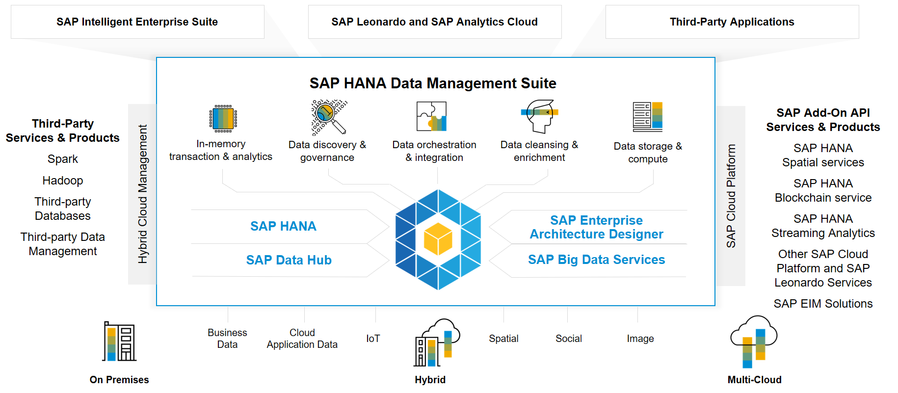
Integration Domains
Integration Styles
Technology Mapping
Data Integration Style SAP HANA Data Management Suite (HDMS)
Explanation
SAP HANA Data Management Suite brings secure, governed enterprise class applications and analytics by providing an open, hybrid, and multi-cloud enabled solution suite that orchestrates all the data into a trusted, unified landscape.
Further Information: SAP HANA Data Management Suite

Slide 53
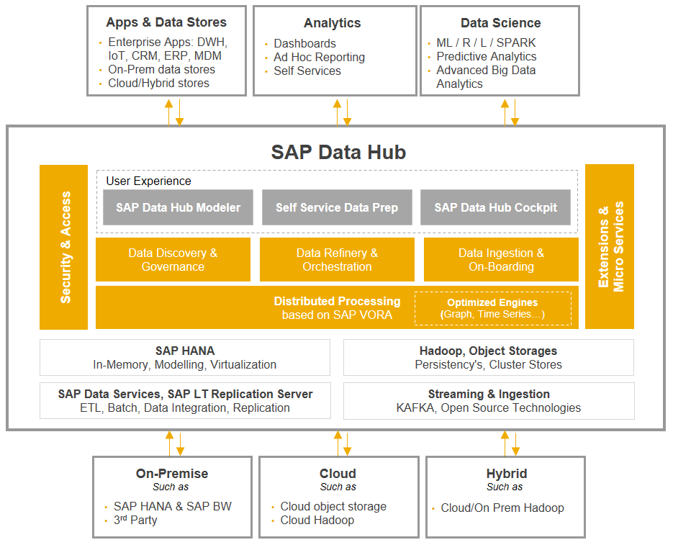
Integration Domains
Integration Styles
Technology Mapping
Data Integration Style SAP Data Hub
Explanation
SAP Data Hub is a data sharing, pipelining, and orchestration solution that helps companies accelerate and expand the flow of data across their modern, diverse data landscapes. SAP Data Hub is part of the SAP HANA Data Management Suite.
On the next slide, guidance is given on when to use SAP Data Hub (data integration style) and when to use SAP Cloud Platform Integration (process integration style).
Source and further Information: CIO Guide: Process and Data Integration in Hybrid Landscapes.

Slide 54
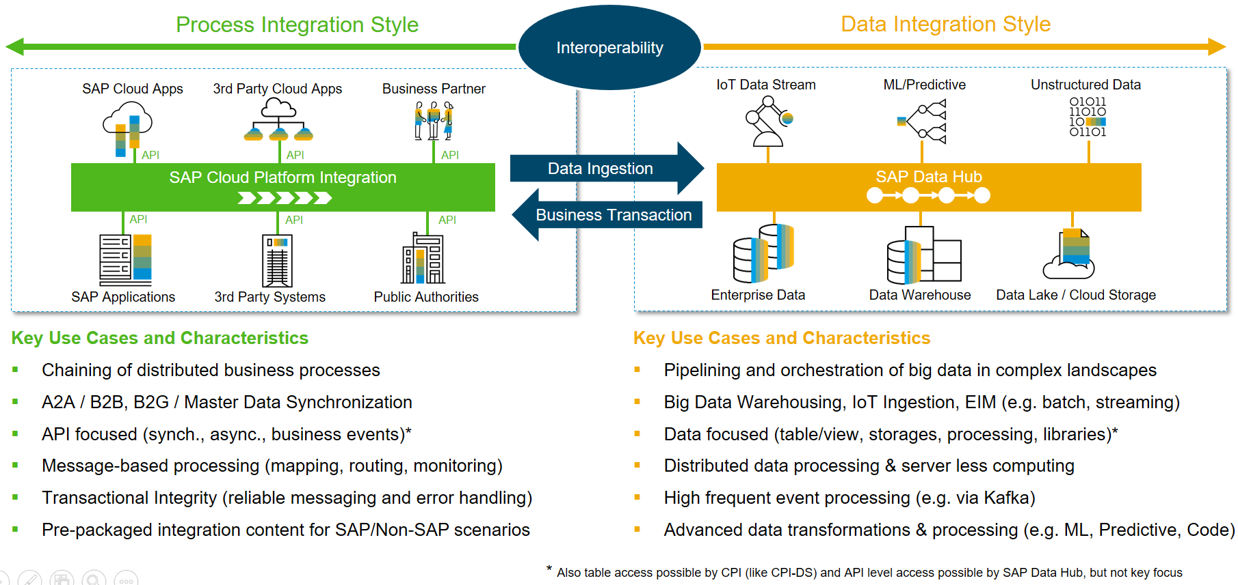
Integration Domains
Integration Styles
Technology Mapping
Technology Guidance SAP Cloud Platform Integration and SAP Data Hub

Slide 55
Integration Domains
Integration Styles
Technology Mapping
Data Integration Style Further Information
Resource | Link | Description
SAP HANA Data Management Suite | Link | SAP HANA Data Management Suite brings secure, governed enterprise class applications and analytics by providing an open, hybrid, and multi-cloud enabled solution suite that orchestrates all the data into a trusted, unified landscape.
SAP Data Hub | Link | Data orchestration solution that discovers, refines, enriches, and governs any type, variety, and volume of data across an distributed data landscape. It is part if the SAP HANA Data Management Suite.
SAP Data Hub FAQ | Link | This blog provides answers to frequently asked questions on the SAP Data Hub and its relationship to existing EIM technologies.
CIO Guide: SAP Vision for Integrating SAP Applications in Cloud and Hybrid Environments | Link | This guide gives guidance on when to use the SAP Data Hub, SAP HANA Smart Data Integration, SAP HANA Smart Data Access, SAP Data Services, SAP Landscape Transformation Server and SAP Cloud Platform Integration.
CIO Guide to Using SAP Technology for Big Data: SAP HANA, SAP Vora, and SAP Data Hub | Link | This guide gives an overview on SAP big data architectures including SAP HANA, SAP Vora and the SAP Data Hub.
SAP Cloud Platform Integration Suite | Link | SAP’s Integration Platform-as-a-Service (IPaaS)
SAP Product Roadmaps | Link | Access all product and solution roadmaps from SAP. You will also find latest roadmaps on all integration technologies and services mentioned in ISA-M.
How To Use
This slides provides links where you can find further information such as additional guidance, product information and roadmaps.

Slide 56
Integration Domains
Integration Styles
Technology Mapping
Integration Technology Mapping Derive Integration Guidelines for Your Organization
A
B
C
D
E
Process Integration
Data Integration
User Integration
Thing Integration
Cross Use Cases

Slide 57
Integration Domains
Integration Styles
Technology Mapping
User Integration Style Overview
Real World Objects
This section provides a decision table template (slide 59) that allows you to define integration guidelines for the user integration style for your organization including the highlighted integration domains. ISA-M is open to also include Non-SAP integration technologies/services.
The ISA-M template also includes examples on how to map this integration style to sample technologies/services from the SAP portfolio.
Important Note: The sample technology mappings given in the next slides are only illustrative examples that need to be aligned with your specific context and requirements. SAP also provides consulting services in case you need further support.
User-Centric Applications
Non-SAP Clouds
How To Use
Non SAP Cloud Apps
User2Cloud
Cloud2Cloud
Thing2Cloud
Cloud2Cloud
…
C/4 HANA
Business Partner
Government Agency
Cloud
OnPremise2Cloud
B2B
OnPremise2Cloud
B2B
B2G
On-Premise
B2G
Business Suite
Non SAP
Business Suite
User2OnPremise
OnPremise2OnPremise
Thing2OnPremise
Process Integration
Process Integration
Data Integration
User Integration
Thing Integration
Cross Use Cases

Slide 58
Integration Domains
Integration Styles
Technology Mapping
User Integration Style Sample Technology Mapping: UI Integration
1
Integration Domain(s) and Integration Style
2
Sample Mapping to SAP Technologies / Services
User-Centric Applications
Real World Objects
SAP Fiori Launchpad
Single point of entry for business applications
Based on SAP Fiori User Experience
Responsive design to run on multiple platforms
Support of multiple deployment options
Key Characteristics
Role-based access
Personalization
Theming and branding via UI theme designer
Open and extensible
Non-SAP Clouds
Non SAP Cloud Apps
User2Cloud
Cloud2Cloud
Thing2Cloud
Cloud2Cloud
…
C/4 HANA
Business Partner
Government Agency
Cloud
OnPremise2Cloud
B2B
OnPremise2Cloud
B2B
B2G
On-Premise
B2G
Business Suite
Non SAP
Business Suite
User2OnPremise
OnPremise2OnPremise
Thing2OnPremise
Process Integration
Process Integration
Data Integration
User Integration
Thing Integration
Cross Use Cases

Slide 59
Integration Domains
Integration Styles
Technology Mapping
User Integration Style Decision Table Template
Integration Guidelines
Integration Technology / Service Sample Values: 1) SAP Fiori Launchpad 2) SAP Cloud Platform Mobile Services 3) SAP Cloud Platform Portal 4) Non-SAP … | Recommendation Degree Sample Values: 1) General Recommendation 2) Reasonable Alternative 3) Possible Exception 4) To be avoided … | Description Optionally: refer to use case patterns | Relevant Integration Domains
 |  |  | User2OnPremise | User2Cloud
SAP Fiori Launchpad | General Recommendation | Use as central entry point for business applications (relates to the UI Integration use case pattern). | ● | ●
SAP Cloud Platform Mobile Services | General Recommendation | Use to develop mobile apps (e.g. iOS and Android apps) and integrate them with backend applications (relates to the Mobile Integration use case pattern). | ● | ●
… | … | …
How To Use
This table allows you to define integration guidelines for the user integration style for your organization. Per row, you can add one integration guideline: In column 1, you can select the relevant integration technology/service for which you want to define the guideline (e.g. SAP Fiori Launchpad). In column 2, you can define the recommendation degree that you would like to assign to the integration technology/service within your organization (e.g. General Recommendation). In column 3, you can further describe your integration guideline, optionally by referring to the relevant use case patterns. Column 4 allows you to assign the integration technology/service to the relevant integration domain(s), e.g. User2Cloud or User2OnPremise.
Important Note: The sample technology mappings shown in the table above are only illustrative examples that need to be aligned with your specific context and requirements. Also the inclusion of Non-SAP integration technologies / services is possible.

Slide 60
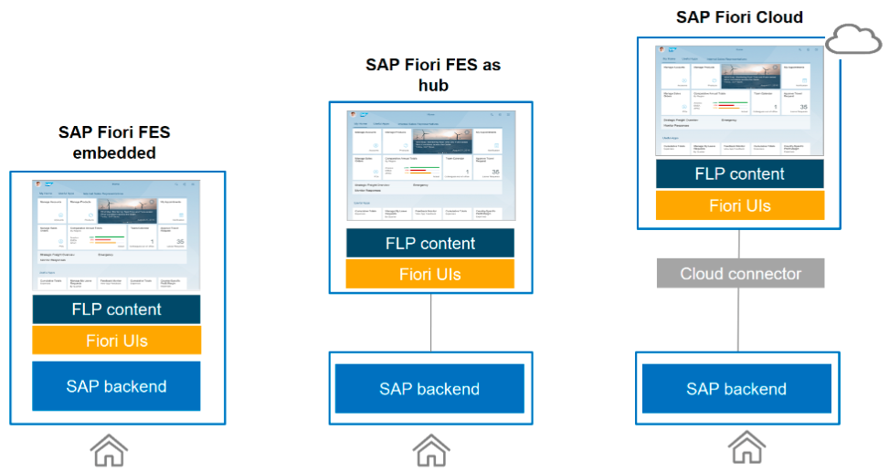
Integration Domains
Integration Styles
Technology Mapping
User Integration Style Example: SAP Fiori Deployment Options
Explanation
Example: SAP Fiori deployment options with an on-premise SAP backend. The main difference of the deployment options is the location, where the SAP Fiori UIs, the FLP content and SAP Fiori launchpad (FLP) as entry point to the applications is deployed.
Source and further Information: SAP Fiori Deployment Options and System Landscape Recommendations

Slide 61
Integration Domains
Integration Styles
Technology Mapping
User Integration Style Further Information
Resource | Link | Description
SAP Fiori Deployment Options and System Landscape Recommendations | Link | In this document, you can find the main SAP Fiori scenarios, the recommended system landscape setup, and the SAP Front-end server deployment options. This document also includes insights into SAP Front-end server hub and embedded deployment and what aspects to consider. The FAQ section provides answers to common questions regarding the SAP Fiori deployment options. Relates to the “UI Integration” use case pattern.
SAP Fiori – OData Provisioning Options | Link | As part of the guide “SAP Fiori Deployment Options and System Landscape Recommendations” an overview is given on the OData Provisioning options.
SAP Cloud Platform Mobile Services | Link | Create and run native, hybrid and micro mobile apps with a mobile app development platform (Enterprise iOS and Android apps). Secure access to on-premise or cloud-based data sources, data-access features and offline OData synchronization. Relates to the “Mobile Integration” use case pattern.
SAP Cloud Platform Portal | Link | Build Digital Experience Portals for employees, customers and partners.
SAP Fiori Cloud | Link | Revamp your user experience with SAP Fiori on SAP Cloud Platform.
UI Theme Designer | Link | Apply your corporate branding to applications based on SAPUI5 technology.
SAP Cloud Platform Integration Suite | Link | SAP’s Integration Platform-as-a-Service (IPaaS)
SAP Product Roadmaps | Link | Access all product and solution roadmaps from SAP. You will also find latest roadmaps on all integration technologies and services mentioned in ISA-M.
How To Use
This slides provides links where you can find further information such as additional guidance, product information and roadmaps.

Slide 62
Integration Domains
Integration Styles
Technology Mapping
Integration Technology Mapping Derive Integration Guidelines for Your Organization
A
B
C
D
E
Process Integration
Data Integration
User Integration
Thing Integration
Cross Use Cases

Slide 63
Integration Domains
Integration Styles
Technology Mapping
Thing Integration Style Overview
Real World Objects
This section provides a decision table template (slide 65) that allows you to define integration guidelines for the thing integration style for your organization including the highlighted integration domains. ISA-M is open to also include Non-SAP integration technologies/services.
The ISA-M template also includes examples on how to map this integration style to sample technologies/services from the SAP portfolio.
Important Note: The sample technology mappings given in the next slides are only illustrative examples that need to be aligned with your specific context and requirements. SAP also provides consulting services in case you need further support.
User-Centric Applications
Non-SAP Clouds
How To Use
Non SAP Cloud Apps
User2Cloud
Cloud2Cloud
Thing2Cloud
Cloud2Cloud
…
C/4 HANA
Business Partner
Government Agency
Cloud
OnPremise2Cloud
B2B
OnPremise2Cloud
B2B
B2G
On-Premise
B2G
Business Suite
Non SAP
Business Suite
User2OnPremise
OnPremise2OnPremise
Thing2OnPremise
Process Integration
Process Integration
Data Integration
User Integration
Thing Integration
Cross Use Cases

Slide 64
Integration Domains
Integration Styles
Technology Mapping
Thing Integration Style Sample Technology Mapping
1
Integration Domain(s) and Integration Style
2
Sample Mapping to SAP Technologies / Services
User-Centric Applications
Real World Objects
SAP Cloud Platform Internet of Things
Part for SAP Cloud Platform Integration Suite
Integrate data from devices and process it in business or analytical IoT applications
Integral part of SAP Leonardo IoT Foundation and SAP Edge Services to build and run IoT applications in the cloud
Key Characteristics
Device Lifecycle Management
IoT specific protocol support (e.g. MQTT, OPC-UA)
Edge-level processing intelligence
Remote software updates
Non-SAP Clouds
Non SAP Cloud Apps
User2Cloud
Cloud2Cloud
Thing2Cloud
Cloud2Cloud
…
C/4 HANA
Business Partner
Government Agency
Cloud
OnPremise2Cloud
B2B
OnPremise2Cloud
B2B
B2G
On-Premise
B2G
Business Suite
Non SAP
Business Suite
User2OnPremise
OnPremise2OnPremise
Thing2OnPremise
Process Integration
Process Integration
Data Integration
User Integration
Thing Integration
Cross Use Cases

Slide 65
Integration Domains
Integration Styles
Technology Mapping
Thing Integration Style Decision Table Template
Integration Guidelines
Integration Technology / Service Sample Values: 1) SAP Cloud Platform Internet of Things 2) SAP IoT Application Enablement 3) SAP Plant Connectivity 4) Non-SAP … | Recommendation Degree Sample Values: 1) General Recommendation 2) Reasonable Alternative 3) Possible Exception 4) To be avoided … | Description Optionally: refer to use case patterns | Relevant Integration Domains
 |  |  | Thing2OP | Thing2Cloud
SAP Cloud Platform Internet of Things | General Recommendation | Use to on-board, configure, integrate and manage remote devices. |  | ●
SAP IoT Application Enablement | General Recommendation | Use this set of microservices to build IoT apps and leverage data storage to deliver real-time insights (complementary to SAP Cloud Platform IoT). |  | ●
SAP Edge Services | General Recommendation | Use to process data on the edge layer, e.g. to provide continuity for critical business functions without reliance on network connectivity (complementary to SAP Cloud Platform IoT). |  | ●
…
How To Use
This table allows you to define integration guidelines for the thing integration style for your organization. Per row, you can add one integration guideline: In column 1, you can select the relevant integration technology/service for which you want to define the guideline (e.g. SAP Cloud Platform Internet of Things). In column 2, you can define the recommendation degree that you would like to assign to the integration technology/service within your organization (e.g. General Recommendation). In column 3, you can further describe your integration guideline, optionally by referring to the relevant use case patterns. Column 4 allows you to assign the integration technology/service to the relevant integration domain(s), e.g. Thing2Cloud or Thing2OnPremise.
Important Note: The sample technology mappings shown in the table above are only illustrative examples that need to be aligned with your specific context and requirements. Also the inclusion of Non-SAP integration technologies / services is possible.

Slide 66
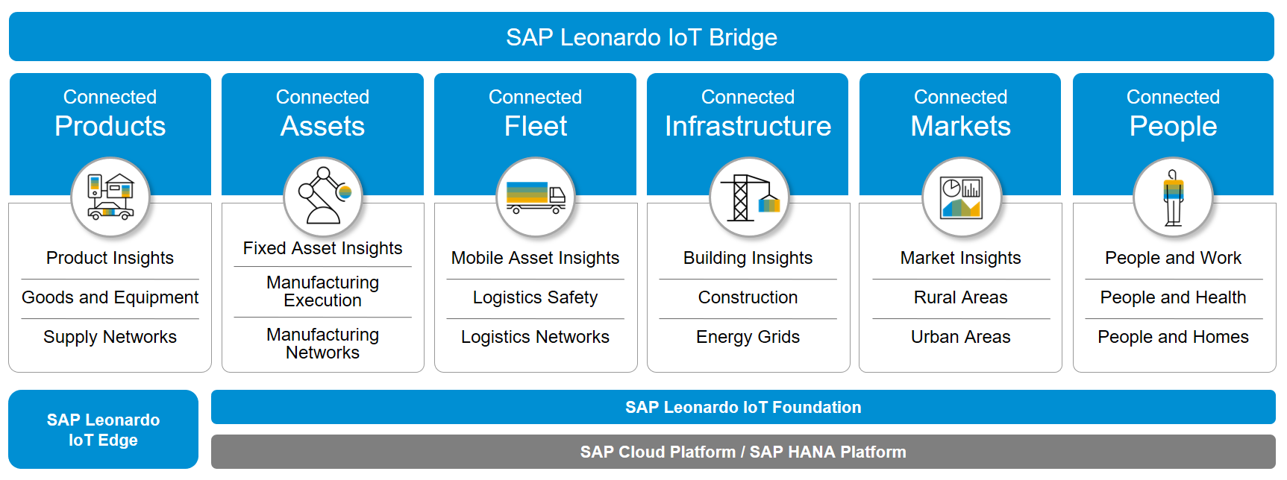
Integration Domains
Integration Styles
Technology Mapping
Thing Integration Style Overview: SAP Leonardo Internet of Things
Explanation
This slides provides an overview on SAP Leonardo Internet of Things.
Source and further Information: Link

Slide 67
Integration Domains
Integration Styles
Technology Mapping
Thing Integration Style Further Information
Resource | Link | Description
SAP Leonardo Internet of Things | Link | Entry page for all IoT related information including IoT applications, IoT technologies and IoT services.
SAP Leonardo Internet of Things: Business Outcomes in a Connected World - Compendium | Link | This guide that provides an overview on SAP’s IoT portfolio.
SAP Cloud Platform Internet of Things | Link | On-board, configure and manage any remote device with our out-of-the-box IoT connectivity and large-scale device management.
SAP Edge Services | Link | Scale and extend cloud functionality to the edge of the network.
SAP IoT Application Enablement | Link | A complete set of microservices designed to build powerful apps and leverage data storage to deliver real-time insights.
SAP Plant Connectivity | Link | Connect your machines to solutions such as SAP MII, manufacturing execution systems (MES), SAP EWM, and more. Deliver Industrial Internet of Things (IIoT) and machine-to-machine (M2M) connectivity to your business.
SAP Product Roadmaps | Link | Access all product and solution roadmaps from SAP. You will also find latest roadmaps on all integration technologies and services mentioned in ISA-M.
How To Use
This table provides links where you can find further information such as refined guidance, product information and roadmaps.

Slide 68
Integration Domains
Integration Styles
Technology Mapping
Integration Technology Mapping Derive Integration Guidelines for Your Organization
A
B
C
D
E
Process Integration
Data Integration
User Integration
Thing Integration
Cross Use Cases

Slide 69
Integration Domains
Integration Styles
Technology Mapping
Cross Use Cases Overview
Cross Use Cases build a category for all use case patterns that complement one ore more of the four core integration styles. For example, API-Managed Integration provides full-lifecycle management for APIs that, e.g. can be leveraged in user- or process-centric integration scenarios. Workflow Management is an other example for a cross use case as it can spawn across process-, user- and data-centric integration scenarios. It also includes all other integration-related use cases such as business rules management or stream analytics.
This section provides a decision table template (slide 71) that allows you to define integration guidelines for the cross use case category for your organization including the highlighted integration domains. ISA-M is open to also include Non-SAP integration technologies/services. The ISA-M template also includes examples on how to map cross use cases to sample technologies/services from the SAP portfolio.
Important Note: The sample technology mappings given in the next slides are only illustrative examples that need to be aligned with your specific context and requirements. SAP also provides consulting services in case you need further support.
How To Use
User-Centric Applications
Non-SAP Clouds
Real World Objects
Non SAP Cloud Apps
User2Cloud
Cloud2Cloud
Thing2Cloud
Cloud2Cloud
…
C/4 HANA
Business Partner
Government Agency
Cloud
OnPremise2Cloud
B2B
OnPremise2Cloud
B2B
B2G
On-Premise
B2G
Business Suite
Non SAP
Business Suite
User2OnPremise
OnPremise2OnPremise
Thing2OnPremise
Process Integration
Process Integration
Data Integration
User Integration
Thing Integration
Cross Use Cases

Slide 70
Integration Domains
Integration Styles
Technology Mapping
Cross Use Cases Sample Technology Mapping: API Managed Integration
1
Integration Domain(s) and Integration Style
2
Sample Mapping to SAP Technologies / Services
User-Centric Applications
Real World Objects
SAP Cloud Platform API Management
Part for SAP Cloud Platform Integration Suite
Provides full lifecycle management for APIs
Can be used in multiple integration domains and styles
Examples
Omnichannel access and mobile
Open real-time B2B Integration
Data access governance and monetization
Key Characteristics
API traffic management policies
API security policies
API analytics and monetization
Non-SAP Clouds
Non SAP Cloud Apps
User2Cloud
Cloud2Cloud
Thing2Cloud
Cloud2Cloud
…
C/4 HANA
Business Partner
Government Agency
Cloud
OnPremise2Cloud
B2B
OnPremise2Cloud
B2B
B2G
On-Premise
B2G
Business Suite
Non SAP
Business Suite
User2OnPremise
OnPremise2OnPremise
Thing2OnPremise
Process Integration
Process Integration
Data Integration
User Integration
Thing Integration
Cross Use Cases

Slide 71
Integration Domains
Integration Styles
Technology Mapping
Cross Use Cases Decision Table Template
Integration Guidelines
Integration Technology / Service Sample Values: 1) SAP Cloud Platform API Management 2) SAP Cloud Platform Enterprise Messaging 3) SAP Cloud Platform Workflow 4) Non-SAP … | Recommendation Degree Sample Values: 1) General Recommendation 2) Reasonable Alternative 3) Possible Exception 4) To be avoided … | Description Optionally: refer to use case patterns | Relevant Integration Domains
 |  |  | User2OP | User2Cloud | OP2OP | OP2Cloud | Cloud2Cloud | B2B/B2G
SAP Cloud Platform API Management | General Recommendation | Use to provide secure, omni-channel access for APIs that are exposed to partners and app developers |  | ● |  | ● | ● | ●
SAP Cloud Platform Enterprise Messaging | General Recommendation | Use to build applications and extensions that can react to events from SAP S/4HANA. Decoupling of apps and services. |  |  |  | ● | ●
SAP Cloud Platform Workflow | General Recommendation | Use to build, run, and manage workflows, from simple approvals to end-to-end processes that span across different organizations and applications. |  | ● |  | ● | ●
… | … | …
How To Use
This table allows you to define integration guidelines for the cross use cases category for your organization. Per row, you can add one integration guideline: In column 1, you can select the relevant integration technology/service for which you want to define the guideline (e.g. SAP Cloud Platform API Management). In column 2, you can define the recommendation degree that you would like to assign to the integration technology/service within your organization (e.g. General Recommendation). In column 3, you can further describe your integration guideline, optionally by referring to the relevant use case patterns. Column 4 allows you to assign the integration technology/service to the relevant integration domain(s), e.g. User2Cloud or Cloud2Cloud.
Important Note: The sample technology mappings shown in the table above are only illustrative examples that need to be aligned with your specific context and requirements. Also the inclusion of Non-SAP integration technologies / services is possible.

Slide 72
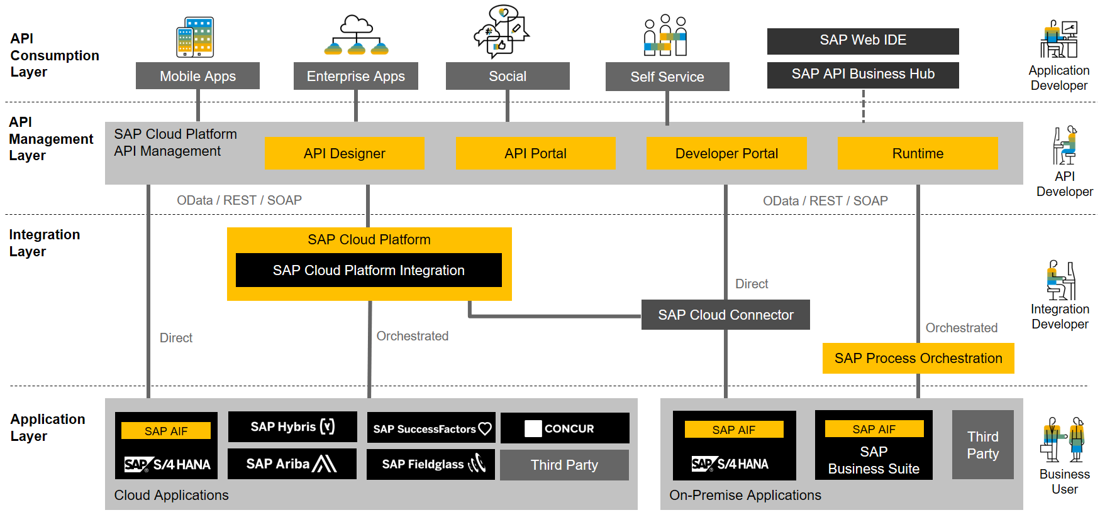
Integration Domains
Integration Styles
Technology Mapping
Cross Use Cases Example: SAP Cloud Platform API Management
Explanation
SAP API Management provides a solution for the full lifecycle management of APIs and complements SAP Cloud Platform Integration and SAP Process Orchestration. It enables use cases like omnichannel access, open real-time B2B Integration or data access governance and monetization.
Source and further Information: CIO Guide: Process and Data Integration in Hybrid Landscapes.

Slide 73
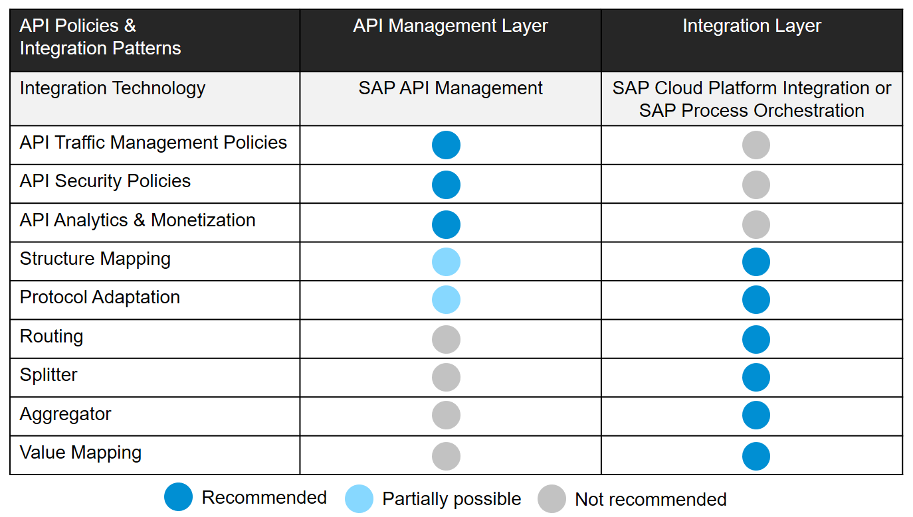
Integration Domains
Integration Styles
Technology Mapping
Cross Use Cases Sample Integration Patterns – API Management and Integration Layer
Explanation
This slide shows some typical API policies and integration patterns that are best implemented in the API management layer or the integration layer. It provides guidance for integration architects on how to combine both offerings and can be extended/adapted to capture best practices in your organization.
Source and further Information: CIO Guide: Process and Data Integration in Hybrid Landscapes.

Slide 74
Integration Domains
Integration Styles
Technology Mapping
Cross Use Cases Further Information
Resource | Link | Description
CIO Guide: Process and Data Integration in Hybrid Landscapes | Link | Among others, this guide gives detailed guidance on the complementary usage of SAP Cloud Platform Integration, SAP Process Orchestration and the SAP Application Interface Framework (AIF). It also includes guidance on the complementary usage of SAP Cloud Platform API Management.
SAP Cloud Platform Integration Suite | Link | SAP’s Integration Platform-as-a-Service (IPaaS): It simplifies integration by connecting people, processes, data, and devices everywhere by allowing people with different skills to leverage a wide variety of integration approaches, intuitive tools, and prepackaged content to achieve results faster and gain business agility with a versatile, dynamic, and enterprise-grade cloud integration platform.
SAP Cloud Platform API Management | Link | Use API management to create simple connected digital experiences for your consumers, partners, and employees. Part of SAP Cloud Platform Integration Suite.
SAP Cloud Platform Enterprise Messaging | Link | Cloud-based messaging and event-enabling service for decoupling application logic and developing microservices. Part of SAP Cloud Platform Integration Suite.
SAP Cloud Platform Workflow | Link | Automate business processes using workflow technology. Part of SAP Cloud Platform Integration Suite.
SAP Cloud Platform Business Rules | Link | Enrich cloud offering with decisions modeling, management and execution service. Part of SAP Cloud Platform Integration Suite.
SAP Streaming Analytics | Link | Process continuous streams of event data in real time and act on the results. Part of SAP Cloud Platform Integration Suite.
SAP Cloud Platform Connectivity | Link | Simply and securely connect cloud and on-premise systems Part of SAP Cloud Platform Integration Suite.
SAP Product Roadmaps | Link | Access all product and solution roadmaps from SAP. You will also find latest roadmaps on all integration technologies and services mentioned in ISA-M.
How To Use
This slides provides links where you can find further information such as additional guidance, product information and roadmaps.

Slide 75
ISA-M Template
Overview
Overview & Terms of Use
1
Integration Roles
2
Integration Domains
3
Integration Styles & Use Cases Patterns
4
Technology Mapping
5
Interface Assessment
6
CIO Guides
7

Slide 76
Interface Assessment
Interface Assessment Overview
A typical task in implementation projects is to blueprint integration scenarios between two applications. Typically, a business scenario is decomposed into technical interfaces.
Next, each technical interface needs to be classified / assessed whether it is a process-, data-, user- or thing-centric integration style. Based on the specific characteristics, the appropriate integration technology/service needs to be selected.
ISA-M supports the classification of interfaces that will we shown on the next slides: in this example a business scenario is decomposed into three technical interfaces: Data Replication, A2A Integration, Mobile Integration.
Business Scenario
How To Use
Application 1
Application 2
?
Interface Decomposition
Application 1
Application 2
?
Process Integration
Data Integration
User Integration
Thing Integration
Cross Use Cases

Slide 77
Interface Assessment
Interface Assessment Sample Interface 1: Data Replication
Analyze Business Scenario
Identify Integration Style and Pattern
Choose Integration Technology
Domain
OnPremise2Cloud
Integration Style & Use Case Pattern Matrix
Decision Table * (Based on Customer Context)
Business Scenario
If not, decompose your business scenario into single interfaces for custom-built integration
Application 1
Application 2
?
Data Replication
2
Option | Integration Technology
1 | SAP HANA Smart Data Integration
2 | …
Interface Decomposition
3
If not, decompose your business scenario into single interfaces for custom-built integration
Application 1
1
Application 2

Slide 78
Interface Assessment
Interface Assessment Sample Interface 2: A2A Integration
Analyze Business Scenario
Identify Integration Style and Pattern
Choose Integration Technology
Domain
OnPremise2Cloud
Integration Style & Use Case Pattern Matrix
Decision Table * (Based on Customer Context)
Business Scenario
If not, decompose your business scenario into single interfaces for custom-built integration
Application 1
Application 2
A2A Integration
?
2
Option | Integration Technology
1 | SAP Cloud Platform Integration
2 | …
Interface Decomposition
3
If not, decompose your business scenario into single interfaces for custom-built integration
Application 1
Application 2
1

Slide 79
Interface Assessment
Interface Assessment Sample Interface 3: Mobile Integration
Analyze Business Scenario
Identify Integration Style and Pattern
Choose Integration Technology
Domain
OnPremise2Cloud
Integration Style & Use Case Pattern Matrix
Decision Table * (Based on Customer Context)
Business Scenario
If not, decompose your business scenario into single interfaces for custom-built integration
Application 1
Application 2
?
Mobile Integration
2
Option | Integration Technology
1 | SAP Cloud Platform Mobile Services
2 | …
Interface Decomposition
3
Application 1
Application 2
1
Mobile

Slide 80
ISA-M Template
Overview
Overview & Terms of Use
1
Integration Roles
2
Integration Domains
3
Integration Styles & Use Cases Patterns
4
Technology Mapping
5
Interface Assessment
6
CIO Guides
7

Slide 81
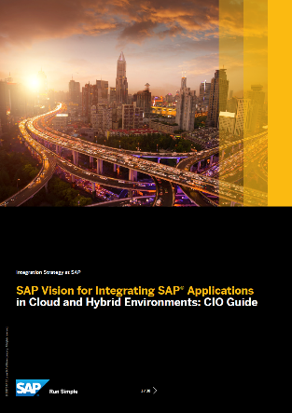
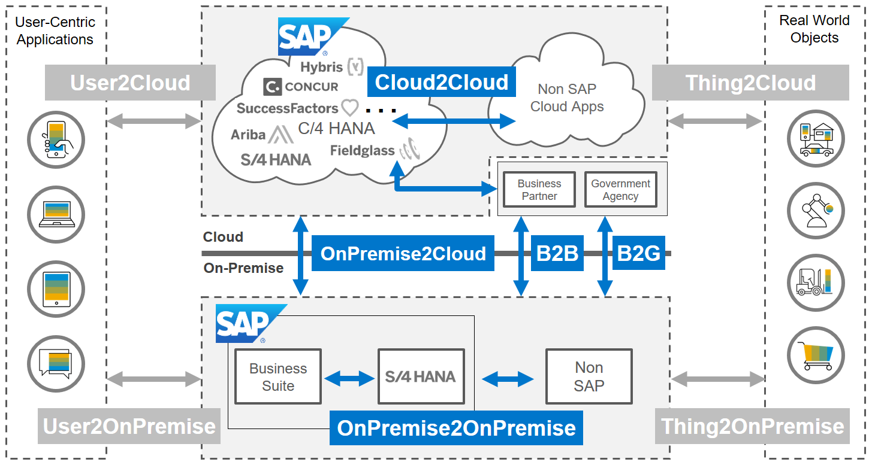
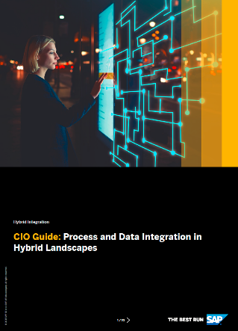
CIO Guides for Integration Complementary Guides for Enterprise Architects
2017
2018
Download
Download
Scope

Slide 82


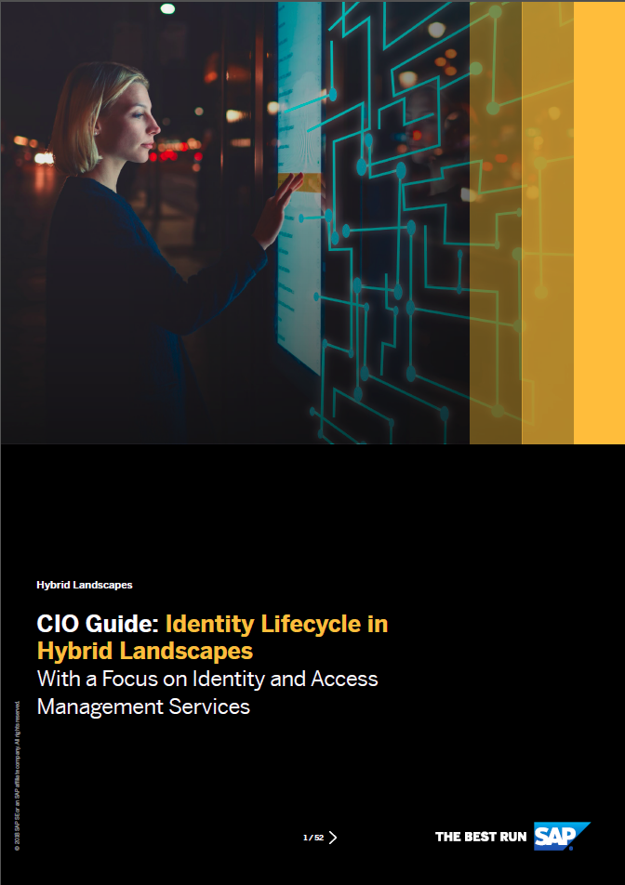
CIO Guides for Integration Further Information & Detailed Technology Guidance
2017
2018
2018
SAP Vision for Integrating SAP Applications in Cloud and Hybrid Environments
Process & Data Integration in Hybrid Landscapes
Identity Lifecycle in Hybrid Landscapes
Describes SAP’s long term Vision for Integration
Key Integration Use Cases
API Alignment
Process Integration Guidance
Data Integration Guidance
Refined Guidance for Process, B2B and Data Integration
Integration Solution Advisory Methodology (ISA-M)
SAP API Strategy
Integration Automation
SAP S/4HANA Transition Guidance
Reference Architecture for Identity and Access Management
Scenarios for Identity and Access Management
Standards for Authentication and Provisioning
SSO with SAP Cloud Platform Identity Authentication
https://www.sap.com/documents/2017/05/eebd96bd-b97c-0010-82c7-eda71af511fa.html
https://www.sap.com/documents/2018/06/de3238a0-077d-0010-87a3-c30de2ffd8ff.html
https://www.sap.com/documents/2018/05/38ce7d25-067d-0010-87a3-c30de2ffd8ff.html

